Slide 1

Toni Morrison
By Angela Huang

Slide 2
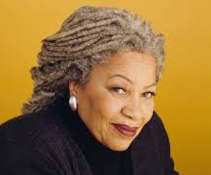
Toni Morrison
(Chloe Anthony Wofford)
Born Feb 18, 1931 in Lorain, Ohio
Died Aug 5 2019 in Bronx, NY (88)
BA at Howard University (1953)
MA at Cornell University (1955)
Taught at Texas Southern University, Howard University, State University of New York, Princeton, a fiction editor for the Random House

Slide 3
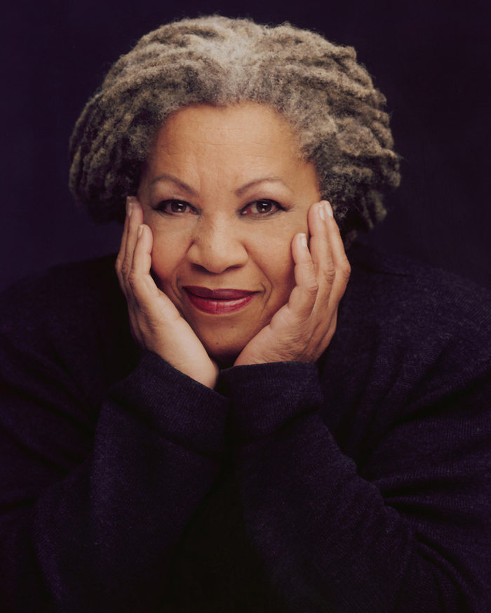
Accomplishments
Nobel Prize for Literature (1993)
National Book Critics Circle Award (1977)
Pulitzer Prize (1988)
New York Times best-seller list
National Humanities Medal (2000)
Coretta Scott King Award (2005)
Officer of the French Legion of Honor(2010)
Presidential Medal of Freedom (2012)

Slide 4

Books
First book: The Bluest Eye
Second book: Sula
Third book: Song of Solomon
Most acclaimed: Beloved
Books written with her son :Who’s Got Game? series, The Book About Mean People (2002), and Please, Louise (2014).

Slide 5

General Theme
Black American’s experience
Characters struggle to find their own and cultural identity
Unjust society
A novel turned poetic
The reality that our world is not as perfect as it seems.

Slide 6
Works cited
https://www.britannica.com/biography/Toni-Morrison
https://www.nytimes.com/2019/08/06/books/toni-morrison-dead.html
Image 1: https://www.rollingstone.com/wp-content/uploads/2019/08/tonimorrison2.jpg
Image 2: https://images.gr-assets.com/authors/1494211316p8/3534.jpg
Image 3: https://images.penguinrandomhouse.com/cover/9780593082164
Image 4 : https://i.pinimg.com/originals/52/58/f8/5258f80056b1d5175469f5a468350d8c.jpg

