Slide 1
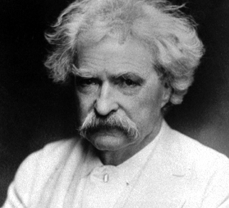

The Life of Mark Twain
Voiced By: Brandon Dinan
This Photo by Unknown Author is licensed under CC BY-ND

Slide 2
Who was Mark Twain?
Real name was Samuel Clemens
World famous author
Best known for his novels
  The Adventures of Tom Sawyer
  The Adventures of Huckleberry Finn

Slide 3
Early Life
Born: November 30, 1835 in Florida, Missouri
Samuel Langhorne Clemens
Sixth Child
Parents
  John
  Jane

Slide 4
Early Life Cont.
Moved to Hannibal, Missouri at age 4
Hannibal was a bussaling, violent, river town on the Mississippi
Dropped out of school at 12 when his father died
Helped the family by getting jobs
Became an apprentice printer at 12
Became a printer at 15

Slide 5
Young Adulthood
Left home and became a Steamboat Pilot at 23
Civil war breaks out in 1861
Joins the Confederates
Only serves a couple week.

Slide 6
Headed Out West
After leaving his unit, Twain heads to Nevada and California(July 1861)
Became a prospector
Later became a reporter for Virginia City Territorial Enterprise
Gained pen name “Mark Twain” (12 ft of water)
Became known in the west for unique narrative style
Had his first big break in 1865 for his story “Jim Smiley an His Jumping Frogs”
Later had his first book, “The Innocents Abroad”, was published in 1869

Slide 7
Love Life
Desire to become rich an climb the social ladder
Married Olivia Langdon on in February 1870
Settled into Buffalo and had four kids

Slide 8
Family
Kids: Jean, Langdon, Susy, and Clara
Langdon died as a toddler due to diphtheria
Susy died of spinal meningitis at 24 in 1896
Jean died of a heart attack in 1909, she also had epilepsy
Clara was distant due to quarrels
Olivia died in 1904 due to a long illness

Slide 9
Late Life/ Mental Health/Death
Spent the last years of his life traveling
Became world known for his writing
Had a world tour 1895-96
After family issues became depressed
Pessimistic
Insensitive, angry, and violent
Died April 21, 1910

Slide 10
Books
The Innocents Abroad
Adventures of Tom Sawyer(1876)
Adventures of Huckleberry Finn(1884)
Prince and the Pauper(1881)
Life on the Mississippi(1883)
Published Ulysses S. Grant memoirs

Slide 11
Works Cited
Biography.com Editors. “Mark Twain.” Biography.com, A&E Networks Television, 10 Sept. 2019, www.biography.com/writer/mark-twain.
“A Life Lived in a Rapidly Changing World: Samuel L. Clemens‚ 1835-1910.” Mark Twain House, 25 Mar. 2020, marktwainhouse.org/about/mark-twain/biography/.

