Slide 1

Eve’s Diary- By Mark Twain
Presentation by CDT Justin Evenson

Slide 2
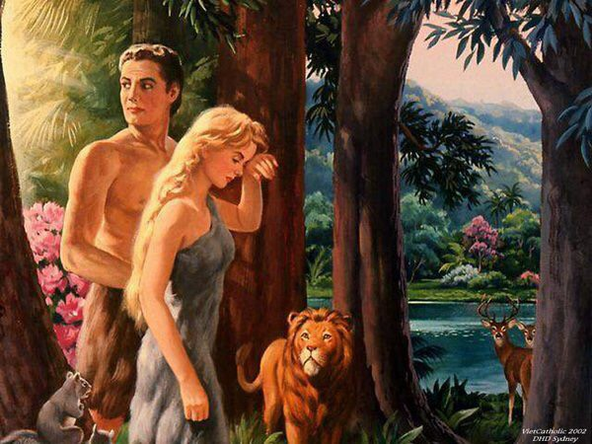
Adam vs Eve
EVE
Smart
Extrovert
Loving, caring
Lover of animals
Compassionate
ADAM
quiet
Strong
Introvert
Only wants what the earth provides
Hard working

Slide 3
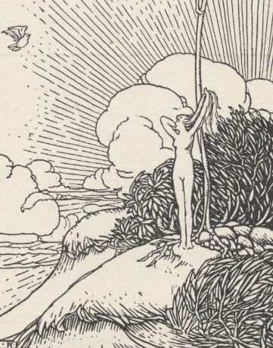
PART I- SYNOPSIS
Written from Eve’s point of view
Everything she sees, she knows the name, even if she didn’t know itbefore
She follows Adam around, not speaking to him
She realizes they are very opposite, but she loves him anyways
Eve experiences her first ”sorrow” when Adam does not want to see her

Slide 4
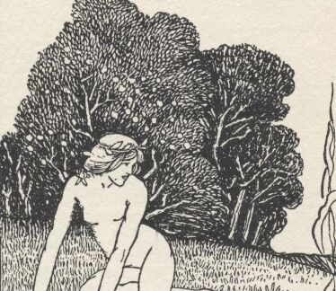
PART II- SYNOPSIS
Eve discovers fire
She learns the pain that happens in the world
Eve learns fear
She sees the destruction but fire becomes masked by its beauty to Eve

Slide 5
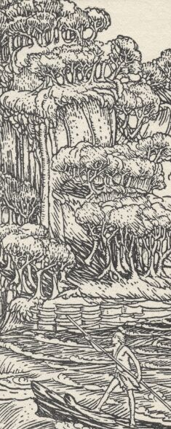
PART III- SYNOPSIS
From Adam’s point of view: He sees her as immature, but loving and full of wonder, and adventurous. He loves her.
He sees her as beautiful
Eve wonders what will happen when she learns everything. Will their still be new things to wonder?
Eve loves Adam because he is “Masculine” and that’s the only reason.

Slide 6
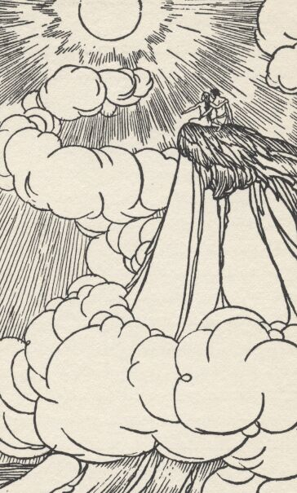
AFTER THE FALL
The story doesn’t talk about the Sin that they made by eating the forbidden fruit, but they are removed from the Garden of Eden
Although the garden is lost, Eve believes that her and Adam have found each other
They will spend the rest of their lives together

Slide 7
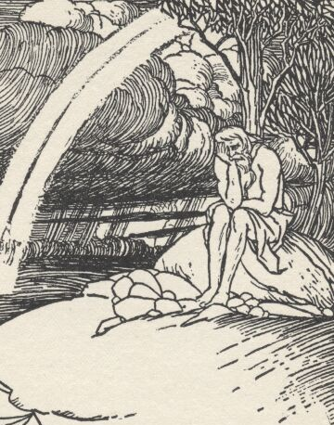
40 YEARS LATER/ AT EVES GRAVE
Eve wants to die first because Adam is stronger than she is
Adam at Eve’s Grave: “Wheresoever she was, THERE was Eden.”

Slide 8

IMPACT
Shows the immediate imperfection of society
Impact people can have on one another
The longing for companionship
Our drive for love is greater than fear

