Slide 1
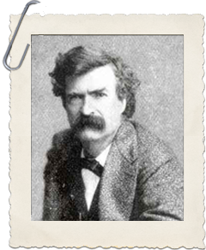

Mark Twain
By: Peyton Hampton

Slide 2
About Mark Twain
Born November 30, 1835
Born in Florida, Missouri
One of the greats of American writers
Real name was Samuel Clemens

Slide 3
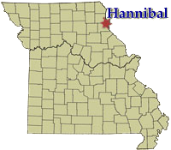
Early Life
Samuel was the 6th of 7 children of John Clemens and Jane Lampton
At age 4 he and his family moved to Hannibal, Missouri
Family struggled financially
Father died in 1847, making things ever harder
Took on several jobs at age 12 to help family with financial burden
Eventually became a typesetter and editorial assistant

Slide 4
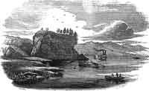
Entering Adulthood
At age 18 Samuel Clemens worked in various cities as a typesetter
  St. Louis, New York City, Philadelphia
Samuel decides to board a steamboat headed for New Orleans at age 22
Ends up training to become a steamboat pilot and eventually does
Worked as a pilot on the Mississippi for several years until the outbreak of the Civil War
Joins the Marion Rangers on the side of the Confederates
  Breaks apart within a couples weeks into the war

Slide 5
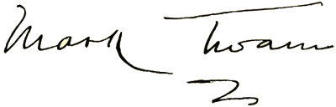
Adulthood
During the war, he moves to Nevada with his brother
Tries gold mining
Returns to journalism
  Develops pen name Mark Twain

Slide 6
Famous Works
The Adventures of Huckleberry Fin
The Adventures of Tom Sawyer
The Celebrated Jumping Frog of Calaveras County
The Innocents Abroad
The Prince and the Pauper
The Gilded Age
Many, many more…

Slide 7
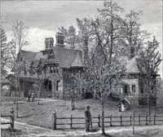
Family
Married Olivia Langdon in 1870
Had 4 children together
  Langdon, Susy, Clara, Jean
Lived in Hartford Connecticut

Slide 8
Struggles and Hardships
Failed businessman
First and only son Langdon died as an young child due to diptheria
Daughter Susy died of Meningitis in 1896
Soon after Susy passed, his wife and other daughter, Olivia and Jean died
Wife died in a fight with illness
Jean suffered from epilepsy but died because of heart issues

Slide 9
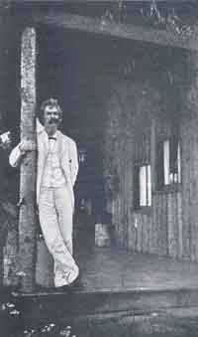
The End
Mark Twain died April 21, 1910
He’s regarded as one of the greatest all time in American Literature

Slide 10
Works Cited
Anirudh. “10 Most Famous Works of Armerican Writer Mark Twain.” Learnodo Newtonic, 9 Sept. 2018, learnodo-newtonic.com/mark-twain-famous-books.
Trout, Carlynn. “Samuel L. Clemens (1835 - 1910).” Historic Missourians, The State Historical Society of Missouri, historicmissourians.shsmo.org/historicmissourians/name/c/clemens/#sectio n5.

