Slide 1
Sherman Alexie
American Novelist
Presentation by CDT Aiden Reinhardt

Slide 2

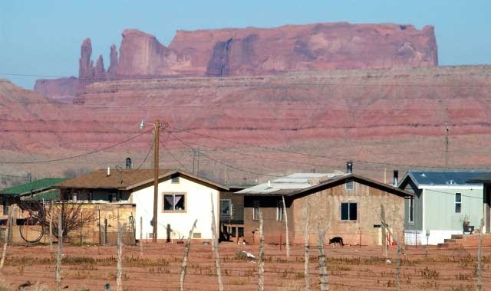

Early Life
Born October 7th, 1966 in Spokane Washington
Lived on the Spokane Indian Reservation with his alcoholic parents
Image from https://www.sutori.com/item/untitled-7c35

Slide 3
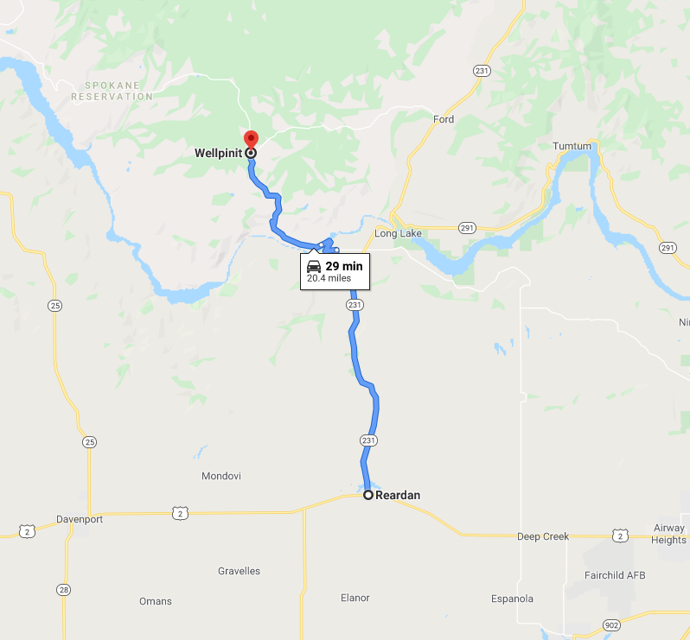
Education
Alexie went to school on the reservation until high school when he made the decision to transfer to a school outside the reservation
From Google Maps

Slide 4

College
After high school, Alexie continued his education at Gonzaga University before transferring to Washington State University and dropping out
Image from https://gozags.com/

Slide 5
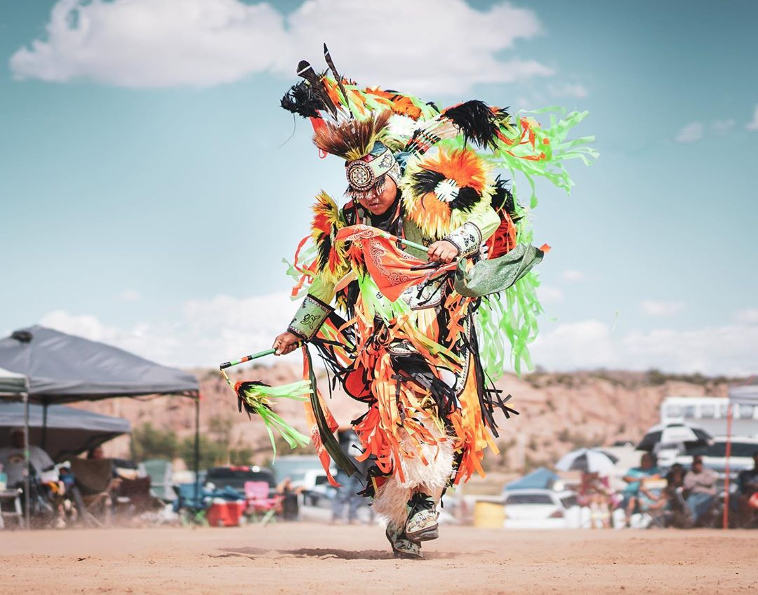
First Works
Alexie started writing in college and The Business of Fancydancing was published in 1992
Throughout the 1990s, Alexie was busy writing poetry and began writing novels
Image from https://gramho.com/media/2273053874796806935

Slide 6


Novels
Alexie’s most successful book, Reservation Blues was published In 1995
Indian Killer followed in 1996
The Absolutely True Diary of a Part-Time Indian (2007)
Flight (2007)
https://www.goodreads.com/book/show/693208.The_Absolutely_True_Diary_of_a_Part_Time_Indian
https://www.goodreads.com/book/show/6159.Reservation_Blues

Slide 7
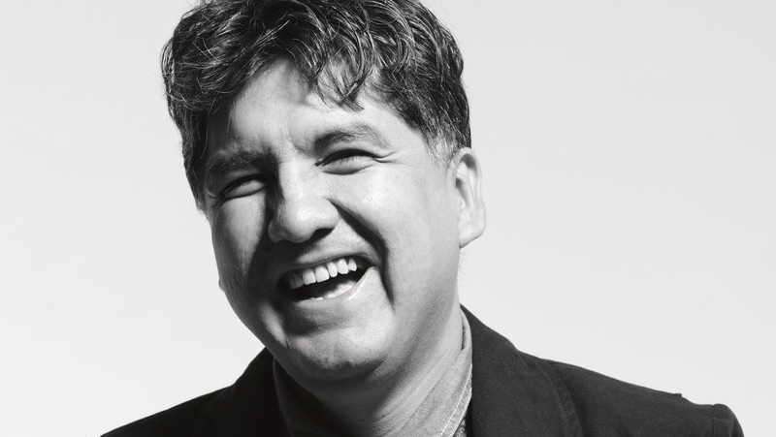
Legacy of Sherman Alexie
First well known Native American Author
Numerous novels, poems, short stories and one film
Multiple awards
https://www.npr.org/2017/06/20/533653471/sherman-alexie-says-hes-been-indian-du-jour-for-a-very-long-day

Slide 8
Sources
https://www.npr.org/2017/06/20/533653471/sherman-alexie-says-hes-been-indian-du-jour-for-a-very-long-day
https://en.wikipedia.org/wiki/Sherman_Alexie
https://poets.org/poet/sherman-alexie
https://www.goodreads.com/book/show/693208.The_Absolutely_True_Diary_of_a_Part_Time_Indian

