Slide 1

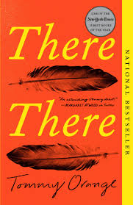


Tommy Orange
Best Selling Novelist
Presented by: CDT Anthony Amaru

Slide 2
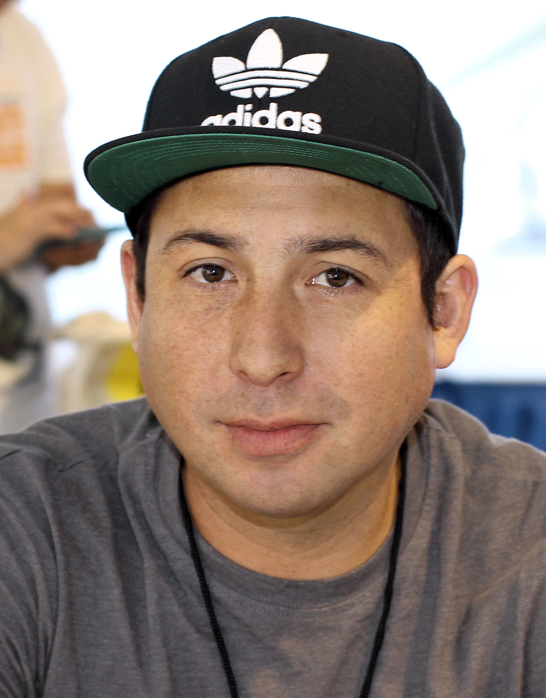
Background
Born: January 19, 1982 in Oakland, California.
Native American:
  Member of both the Cheyenne and Arapaho tribes.
Residence: Currently lives in Murphys, California
There There was his first book.

Slide 3
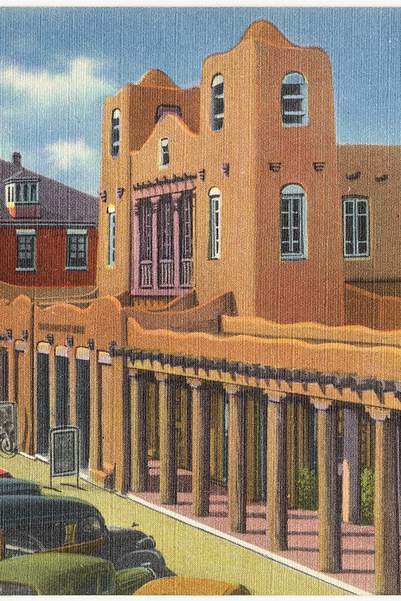
Education
Graduate of Institute of American Indian Arts in Santa Fe, New Mexico.
  Listed as a notable Alumni
Has a masters in Fine Arts.
The Building to the Right is the Santa Fe Federal Building where the Institute of American Indian Arts is located. It is an extremely historic building in Santa Fe as it used to be the Post Office and it is currently the location of the Museum of Contemporary Native Arts.

Slide 4
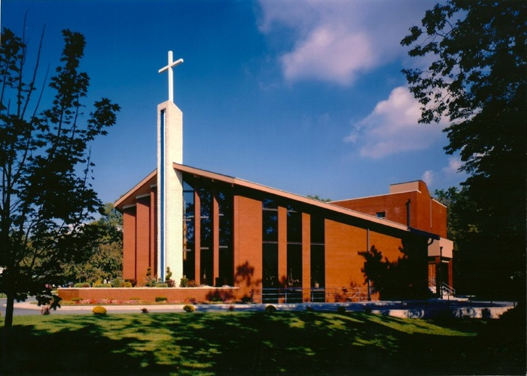
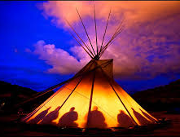
Heritage
Member of Cheyenne and Arapaho Tribes
His father spoke Cheyenne as his first language.
  Was a Native American Church Ceremony leader
His mother was a white “wandering hippie and spiritual seeker.” (Alter)
  She converted to evangelical Christianity and denounced Tommy’s Father’s practice as demonic.

Slide 5
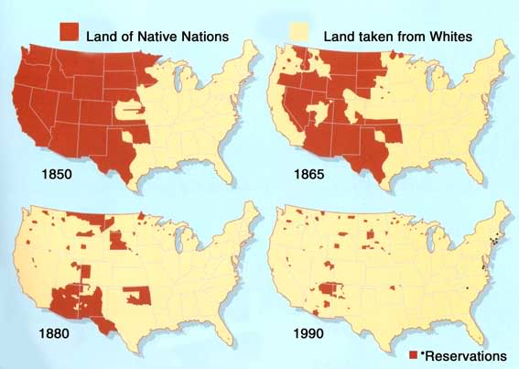
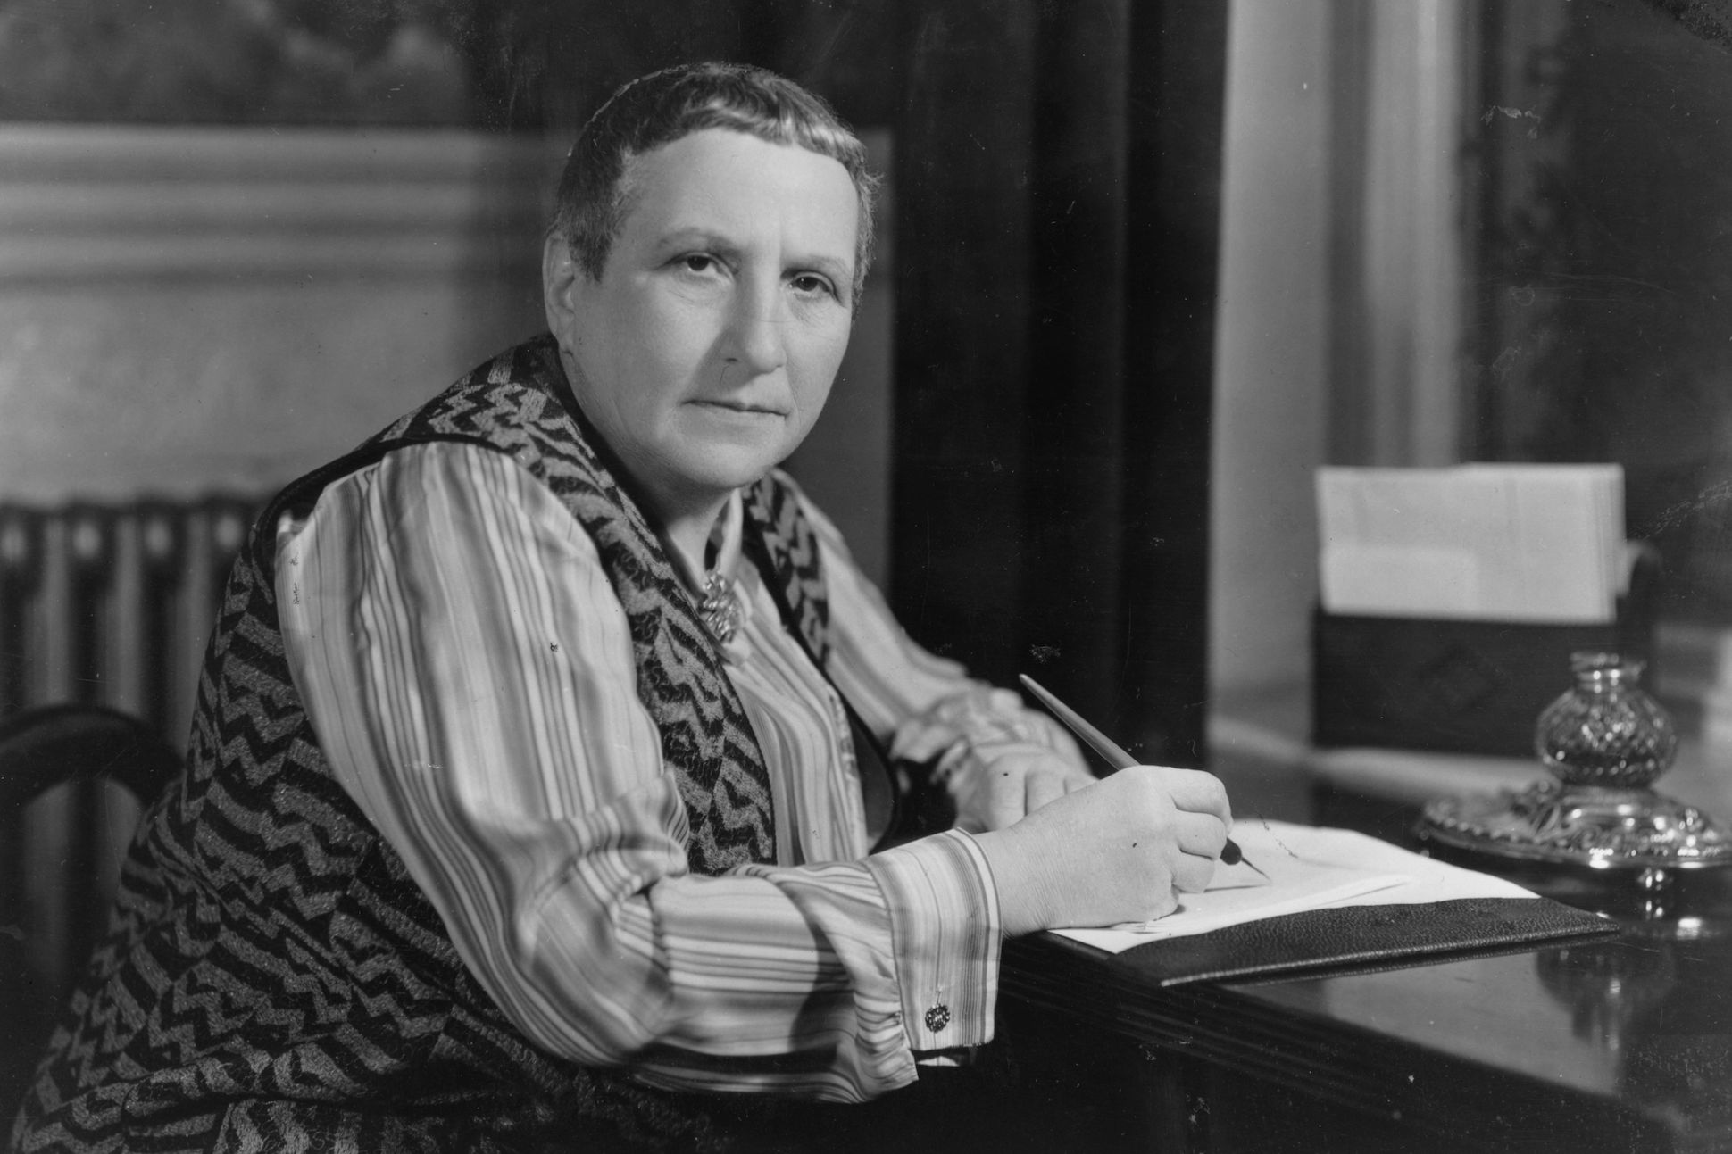
There There Inspiration
Grew up stuck between two worlds
  Native American and Evangelical
Believed cities and towns represented absence of Native Homeland and that “There is no there there.” (Alter)
  Quote from Gertrude Stein about Oakland, CA
“Urban Indian”
(There are two recordings for this slide, Please make sure you listen to both)

Slide 6
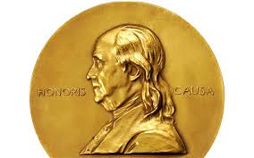


Awards
Recipient of 2019 American Book award
  Recognizing his “outstanding literary achievement” (American Book Awards)
Recipient of the 2019 PEN/Hemingway award.
  “honoring a distinguished first novel” (“Tommy Orange Wins”)
Recipient of 2018 John Leonard’s award
  AKA National Book Critics Circle Award
There There was a finalist for the 2019 Pulitzer Prize.
Shortlisted for 2019 Andrew Carnegie Medal for Excellence in Fiction.
Awarded a Gold Medal for First Fiction by the California Book Awards.

Slide 7
Bibliography:
Alter, Alexandra. “Tommy Orange's 'There There' Is a New Kind of American Epic.” The New York Times, The New York Times, 31 May 2018, www.nytimes.com/2018/05/31/books/tommy-orange-there-there-native-american.html.
“American Book Awards.” Wikipedia, Wikimedia Foundation, 13 Mar. 2020, en.wikipedia.org/wiki/American_Book_Awards.
“Institute of American Indian Arts.” Wikipedia, Wikimedia Foundation, 30 Mar. 2020, en.wikipedia.org/wiki/Institute_of_American_Indian_Arts.
“Tommy Orange.” Wikipedia, Wikimedia Foundation, 31 Jan. 2020, en.wikipedia.org/wiki/Tommy_Orange.
“Tommy Orange Wins 2019 PEN/Hemingway Award-His 3rd Prestigious First-Novel Prize-for THERE THERE.” Penguinrandomhouse.com, global.penguinrandomhouse.com/announcements/tommy-orange-wins-2019-penhemingway-award-his-3rd-prestigious-first-novel-prize-for-there-there/.

