Slide 1



“The Sniper”
Liam O’Flaherty
By Cadet Bryan Lowe

Slide 2
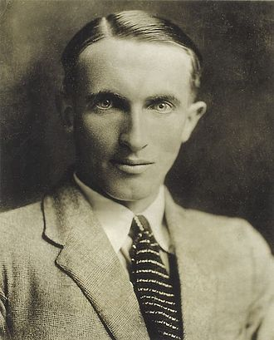
Liam O’Flaherty
Born 28 August 1896 –Died 7 September 1984
Inishmore, Ireland
WWI Irish Guards (Western Front)
Founded Communist Party of Ireland
Author

Slide 3
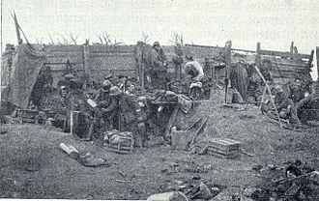
The War
Enlisted in 1917 in the British Army
Served on the Western Front
Severely injured in the Battle of Langemarck
3rd Battle of Ypres (Second of Langemarck)
Belgium

Slide 4
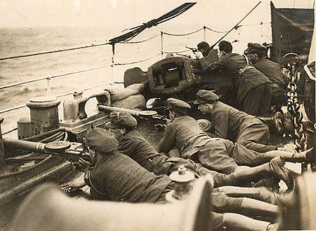
The Sniper
Irish Civil War (1922-1923)
Two Snipers
Brothers
Opposite Sides of the War (Irish Free state
And IRA)

Slide 5
Other Works
Thy Neighbour’s Wife
The Informer
The House of Gold
Hollywood Cemetery
Famine
Insurrection
Short Stories
Civil War
The Shilling
Going into Exile

Slide 6
Sources
https://en.wikipedia.org/wiki/Liam_O%27Flaherty
https://en.wikipedia.org/wiki/Irish_Civil_War

