Slide 1
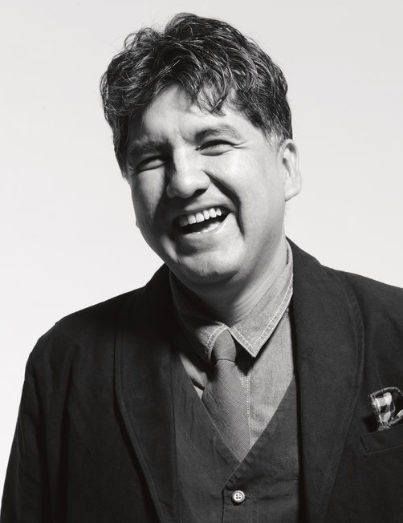

Sherman Alexie
All about:
Poet, writer, performer, filmmaker
By: Christina lyons

Slide 2
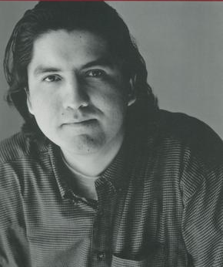
Early Life/bio:
Alexie grew up on the Spokane Indian Reservation in Washington
He began to write poetry and short stories in college at Washington State University
Alexie abused alcohol; however, he became sober after his first poem was published.
Alexie’s experience with alcohol abuse on Native American reservations became an inspiration for his work

Slide 3
Alexie’s major themes:
Alcoholism
Poverty
Crime
Life on a reservation vs white American society
Sadness, and compassion for those less fortunate

Slide 4

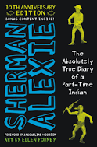

Popular books and films
BOOKS:
  The Absolutely True Diary of a Part- Time Indian (2007)
  The Lone Ranger and Tonto Fistfight in Heaven (1993)
  The Business of Fancydancing
  Reservation Blues (1995)
  Indian Killer (1996)
  War Dances (2009)
FILMS:
  helped create Smoke Signals, the first all- Indian movie (1993)
  Directed the movie for his book The Business of Fancy- Dancing (2002)

Slide 5
“What you pawn I will redeem”
In the beginning of the story, Alexie describes his own situation
but then says he flunked out of college, married several times, and went crazy
Poverty, homelessness, helplessness
Themes in the short story similar to life on a reservation

Slide 6

now:
Awards:
PEN/ Faulkner Award for The Lone Ranger and Tonto
National Book Award for Young People’s Literature
On the Best of Young American Novelists list (1996)
Famous public speaker
Guest on radio and TV programs
Lives in Seattle with his wife and 2 sons
53 years old

Slide 7
BibliOgraphy:
Casey, Rob. “Sherman Alexie.” Poetry Foundation, Poetry Foundation, 2010, www.poetryfoundation.org/poets/sherman-alexie.
“Conversations with Sherman Alexie.” University Press of Mississippi, www.upress.state.ms.us/Books/C/Conversations-with-Sherman-Alexie.
  Used for 2nd image of Alexie
Gross, Terry. “Sherman Alexie Says He's Been 'Indian Du Jour' For A 'Very Long Day'.” NPR, NPR, 20 June 2017, www.npr.org/2017/06/20/533653471/sherman-alexie-says-hes-been-indian-du-jour-for-a-very-long-day.
  Used for 1st and 3rd images of Alexie and slides
SparkNotes, SparkNotes, www.sparknotes.com/lit/the-absolutely-true-diary-of-a-part-time-indian/summary/.
  When I talked about The Absolutely True Diary of a Part-time Indian
Alexie, Sherman, and Brandi. “The Lone Ranger and Tonto Fistfight in Heaven Summary.” GradeSaver, www.gradesaver.com/the-lone-ranger-and-tonto-fistfight-in-heaven/study-guide/summary.
  When I talked about “The Lone Ranger and Tonto Fistfight in Heaven”

