Slide 1
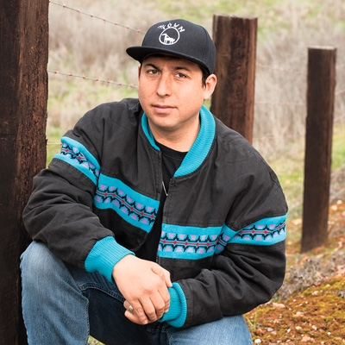

Tommy Orange
By: Daniel Hoffman

Slide 2

Works
There There
  First and only novel written in 2018
  Idea came to him while he was working in the
  urban Indian communities
  Listened to many stories from the people there
  and decided to tell stories of a lesser known community
  through a book.

Slide 3

There There Overview
Multiple Narrators
  Introduced throughout the four parts
Part 1
  Tony Loneman, Dene, Opal Bear Shield
Part 2
  Bill, Calvin, Jacquie, Orvil Red Feather
Part 3
  Octavio, Daniel, Blue, Thomas Frank
Part 4
  Stories intertwine

Slide 4
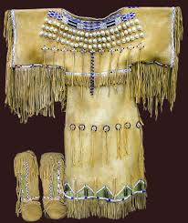
Early Life and Background
Raised in Oakland, California
  Setting for There There
  Mom’s side
Visits Oklahoma
  Dad’s side and fluent in Cheyenne
  Also Arapaho bloodline
Worked Oakland
  Urban areas in mental health
Traditional Cheyenne clothing

Slide 5

Identity
Cheyenne and Arapaho
  Native from Oklahoma
  Visited with Dad
Struggle
  Natives are a minority
  Many Natives live in cities and don’t experience their own culture
  Orange felt this lack of identity

Slide 6
Analytical Question
Although we have not officially started There There, it is a fictional novel written over the course of six years. It is narrated by different characters who all end up going to the same powwow in Oakland. Orange talked to many Native Americans who live in the city and some of the character’s experiences were based off of the real life experiences, but he only used parts of the real stories. Why did Orange choose to create a fictitious work, but incorporate real experiences as opposed to writing a book as a collection of real stories from real people?

Slide 7
Works Cited
“A Q&A With Tommy Orange, Author of June's #1 Indie Next List Pick.” The American Booksellers Association, American Booksellers Association, 23 May 2018, www.bookweb.org/news/qa-tommy-orange-author-junes-1-indie-next-list-pick-104530.
Staff. “Cheyenne Indians – Tribe History, Location and Culture.” Only Tribal, 26 Sept. 2016, www.onlytribal.com/cheyenne-indians-tribe-history-location-and-culture.asp.
“There There Summary & Study Guide.” BookRags, BookRags, www.bookrags.com/studyguide-there-there/#gsc.tab=0.

