Slide 1
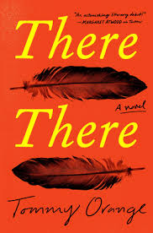

Literary Devices in “There There”
Emma Macdonald

Slide 2
Foreshadowing
-author gives an advanced hint of what will happen later in the story
“ ‘This is how we’re gonna rob that powwow,’ I finally heard Octavio say…The night before the powwow, Octavio called me and told me I was gonna have to be the one to hide the bullets.” (Tony’s chapter)
Subsequent characters mention involvement with the Big Oakland Powwow
  Dene (filmmaker)
  Opal & Orvil (dance competition)
  Edwin (internship to assist with event)

Slide 3
Epigraphs
-a phrase, quotation, or poem set at the beginning of a document to introduce overarching theme
Prologue: “In the dark times will there also be singing? Yes, there will also be singing. About the dark times.” –Bertolt Brecht
Part 1: “How can I not know today your face tomorrow, the face that is there already or is being forged beneath the face you show me or beneath the mask you are wearing, and which you will only show me when I am least expecting it?” –Javier Marías
Part 2: “A feather is trimmed, it is trimmed by the light and the bug and the post, it is trimmed by little leaning and by all sorts of mounted reserves and loud volumes. It is surely cohesive.” –Gertrude Stein
Interlude: “What strange phenomena we find in a great city, all we need to do is stroll about with our eyes open. Life swarms with innocent monsters.” –Charles Baudelaire
Notes:
Prologue details “dark times” in history in which people continue to sing about in more ways than one…as trauma expressing itself generations later. (german)
Part 1, beneath the mask is generations of trauma which will come to at the powwow (Spanish)
Part 2, every action causes something (American)
Part 3, in modern world, there are so many people but no one really connects on an intimate level (French)

Slide 4
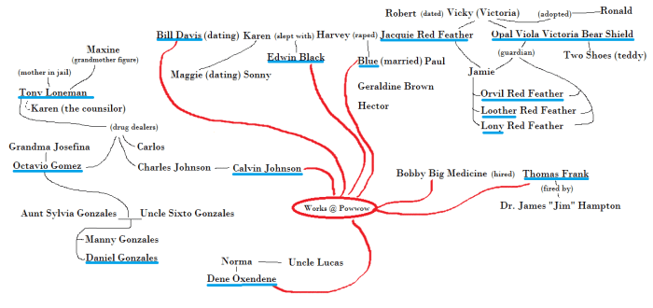
Point of View
-mode of narration that an author employs to let the readers hear and see what takes place
Tommy Orange enables various narrations
  Each narrator will end up in the same place (Big Oakland Powwow)
Via “The Lexington Bookie”

Slide 5
Amplification
-rhetorical device to embellish a statement to add further information
“The bullets will come from the Black Hills Ammunition plant in Black Hills, South Dakota…” proceeds with description
  Causes reader to consider deeper and provokes emotional response
  Ties back to epigraph quote of feather
Notes:
A feather is trimmed, it is trimmed by the light and the bug and the post, it is trimmed by little leaning and by all sorts of mounted reserves and loud volumes. It is surely cohesive.” Gertrude stein

Slide 6
Personification
-attribution of human characteristics to something nonhuman
Death of Dene’s uncle:
“Wind howled into the tunnel. At him. It seemed to breathe. It was a mouth and a throat.” (pg. 43)
Allusion
-reference to people, places, events, or literary works
“The bullets have been coming for miles. Years.”
  -Reference to bullets fired by colonists and westward expansionists
Colloquialism
-use of informal language/slang to add realism to characters
“gonna” “d’you” “hella” “I’m’a”
Notes:
-connection with nature and spirit of Native American culture

Slide 7
Discussion Question
Tommy Orange enables various literary devices to add to the complexity and emotional impact of his story. While some are stylistic approaches in certain words or phrases, some span the entirety of the novel. How do different devices persuade or inspire the audience, and what do they reveal about the underlying message and author’s purpose?

Slide 8
Sources
https://thelexingtonbookie.com/2018/11/02/there-there-by-tommy-orange/
https://blog.prepscholar.com/list-of-literary-devices-techniques

