Slide 1

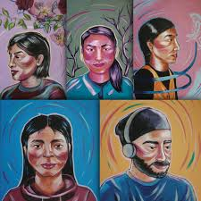
There, There Character List & Analysis
CDT Myles Garrett
E-2, 2023

Slide 2
Character Summary
The novel contains numerous characters that act as narrators for the story in general. While the development of each character does not go into deep explanation and progression as other novels may, they allow the reader to make their own assumption via imagination and life experiences, similar to the process many short stories follow. All the characters’ perspectives and stories intertwine and involve each other in some way throughout the novel.

Slide 3
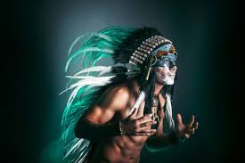
Character List
Major Characters:
Tony Loneman
Dene Oxendene
Opal Viola Victoria Bear Shield
Jacquie Red Feather
Edwin Black
Calvin Johnson
Orvil Red Feather
Octavio Gomez
Blue
Harvey
Bill Davis
Daniel Gonzales
Ronald

Slide 4

Tony Loneman
His character follows his name of being lonely
  Much of a loner, picked on and isolated due to his “strange face” and disfigurement (caused by fetal alcohol syndrome; “the Drome”)
Has inner conflicts with himself
  Sees himself as a monster
His intelligence is quite low, but his counselors constantly try pointing out how he is smart in his own way
His path of selling drugs introduces him to Octavio, leading to his involvement of the Big Oakland Powwow robbery
The novel shows that his skill of invisibility and hypervisibility leads him to feel depressingly lonely
His death at the end of the novel is described as him being freed from himself
  No longer has to hide behind his “mask” that has belittled him

Slide 5
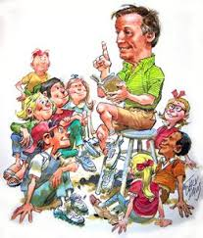
Dene Oxendene
A natural storyteller that searches Oakland to find stories from the Native American population
  Finishing the project his dead uncle left him to finish
He is an artist through graffiti art; tagged the name “Lens” throughout Oakland
  The name “Lens” suggests that he offers a way to spotlight the stories of others’ perspectives
He never puts his own stories out for display, only others
  Does this because he believes that the most worthy works are those from others who are pushed away from society, so that others who feel the same can feel that they are heard and noticed
Takes duty as a story collector very seriously, but also finds tremendous gratitude and hope from the stories he hears from those from Urban Indian communities within Oakland

Slide 6
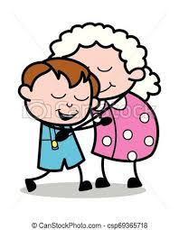
Opal Viola Victoria Bear Shield
Character introduction begins with her as a child (12) being taken through the Native occupation on Alcatraz Island by her mother
She is with her sister, Jacquie, and her mother who posses a drinking problem
  Her mother’s obsessive drinking and her sister’s involvement with a sketchy group of teens leads Opal to feel isolated and alone
After leaving island, their mother dies and they are left to the care of their sexually abusing uncle
  Opal defends her pregnant sister from her uncle by hitting him with a bat and fleeing the house
Falls in love with a man named Lucas, but he leaves her to Los Angeles
  Lucas returns years later to give Opal his Native regalia before passing
Opal struggles with raising her sister’s grandchildren with a Native background
  Due to pain and violence she experienced herself, but eventually the boys learn of their background and got to Oakland for the powwow
She is quiet, fierce, and caring mother figure

Slide 7
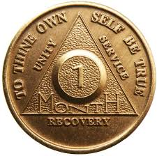
Jacquie Red Feather
Introduction begins with her as a teenager on Alcatraz with the Native community
She brings along her sister, Opal, on all her adventures, but begins to seperate once she falls for a boy named Harvey
  Harvey assaults Jacquie and gets her pregnant; gives child up for adoption
Later seen in the novel when she is in her sixties, struggling to hold sobriety
  Gives her grandchildren to be cared for by her sister Opal due to being unable to care for them after her second daughter’s suicide
She is able to stay sober, and reconnects with Harvey
  Decides to join Harvey at the Oakland powwow
She is strong and resilient, and also admits to her own mistakes and grows from them
Opens to her family after constantly keeping them out from her feelings

Slide 8

Edwin Black
Isolated and confused half-Native man that lives with his mother, searching for his father through Facebook
Is confused when he cannot make the connection of the Native-American culture he studied compared to what he experienced in his own life
He is constantly uneasy in being fully involved in the world around him due to the unsureness of himself
  Begins to find out more about himself and make smarter choices as the novel progresses
Works as an intern at the powwow, where he meets new friends, his half-sister Blue, and reunites with his father

Slide 9
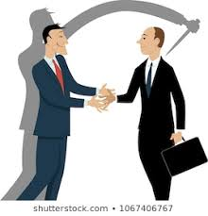
Calvin Johnson
Native man; on the powwow committee in Oakland
Lives with sister and niece
His brother Charles approaches him for serious help
  Charles got involved with drug dealers, and hopes Calvin can help take off pressure for him
Calvin ends up getting involved in Octavio’s robbery plan
  Betrays his people in order to help his family and ultimatey himself
Gets injured during the robbery
Represents the the nature of violence and trauma, showing how it can lead people to betray those they love

Slide 10
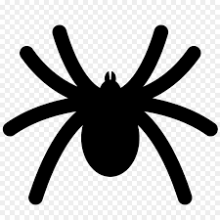
Orvil Red Feather
14 year-old Native boy raised by great aunt Opal along with his two brothers
Being kept from their Native heritage from Opal because of her fears and experiences with the Native community
Compelled and determined to learn more about the culture
  Researches dances on YouTube so he can perform in the powwow and win the cash prize for his aunt
One day, he gets the urge to scratch a lump that has been on his leg a couple of years
  Spider legs emerge, showing how he is finally ready to become a man of his Native people

Slide 11
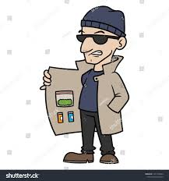
Octavio Gomez
Oakland drug dealer
  Intimidating, but has an immense love for his family that is kept underneath
Experienced great loss; lost brother and mother in drug-related violence
Gets in trouble with his “bosses” and decides to rob the Oakland Powwow in order to get out of it
  Hopes to use money for his family; shows that violence sometimes has good intentions
Narrative shows empathy towards Octavio, saying that the events that occurred would eventually happen because of prior events of violence

Slide 12
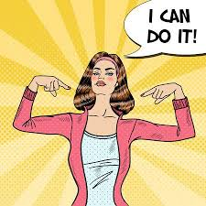
Blue
Child of Jacquie and Harvey, half-sister of Edwin
  Given up for adoption during Jacquie’s part of the story
Adopted at birth by rich white family, grew up knowing she was Native American but never connected to her culture/roots
Traveled to Oklahoma to learn more about her culture, and ended up marrying a Native man named Paul
  Paul became abusive after his father’s death, so Blue left back to Oakland
She is deeply invested in her Native community
  Quiet, confident, and empathetic towards others
Is there for edwin in his time of need at powwow

Slide 13

Harvey
First introduced as risky heavy drinking teen
Blue’s and Edwin’s father
He finds sobriety after years of being an alcoholic
Attends AA meetings and reunites with Jacquie
Acknowledges that he has let others down and searches for redemption and forgiveness

Slide 14
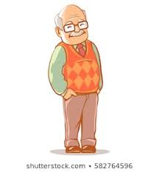
Bill Davis
Boyfriend of Edwin’s mother
Native man that works at the Oakland Coliseum
Devoted to both Edwin and his mother, even though Edwin is not very fond of him
  Risks his life at powwow in order to find and save Edwin; loses life
Kind and wise; misses the age where technology did not control society

Slide 15

Daniel Gonzales
Octavios cousin
  Tech wiz and great with technology; hacker type
Creates 3-D printed guns for the powwow robbery
Owns a drone that he flies around Oakland
  Offers to the readers different points of views of the city and story

Slide 16
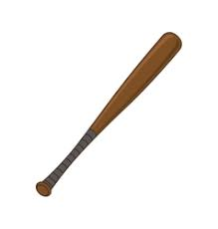
Ronald
“Uncle” to Jacquie and Opal
Sexually abusive toward the girls as he is constantly lusting over them
Gets attacked by the girls after he tries sexually assault Jacquie while she was sleeping

Slide 17
Character Conclusion
All the characters’ perspectives and stories intertwine and involve each other in some way throughout the novel. The unity of all the stories is joined together ultimately at the end of the novel at the Oakland Powwow, creating a connection of culture and emotion.

Slide 18
Works Cited
“July: ‘There There’ by Tommy Orange.” Literary Affairs, literaryaffairs.net/there-there-by-tommy-orange/.
LitCharts. “There There Characters.” LitCharts, www.litcharts.com/lit/there-there/characters.
Orange, Tommy. There There. Emblem Editions, 2020.

