Slide 1
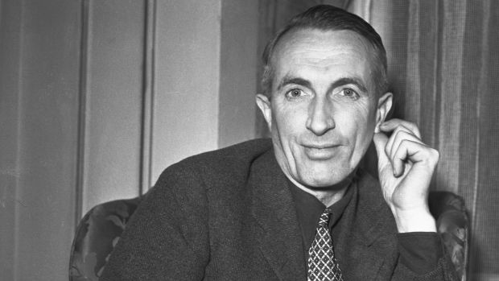

Liam O’Flaherty
By Gregg Puttkammer

Slide 2
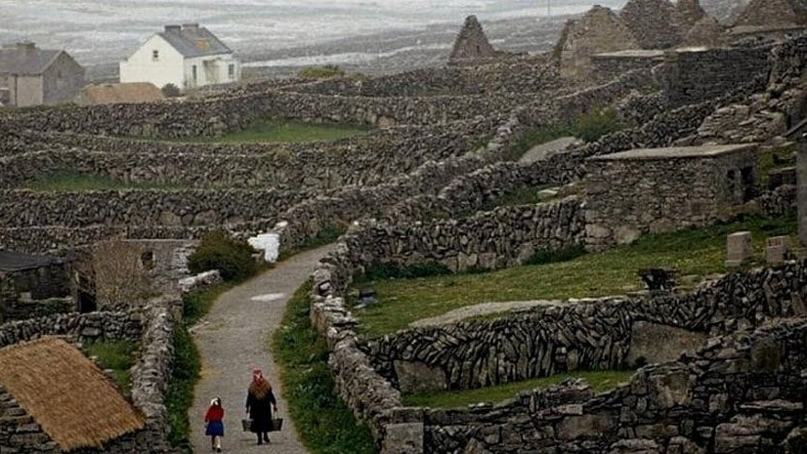
General info
Born 1896 – Aran Islands, Ireland
Died 1984 – Dublin, Ireland
Leading Figure of the Irish Renaissance
Irish till the end

Slide 3
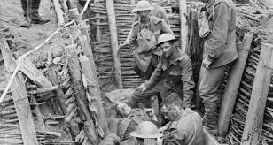
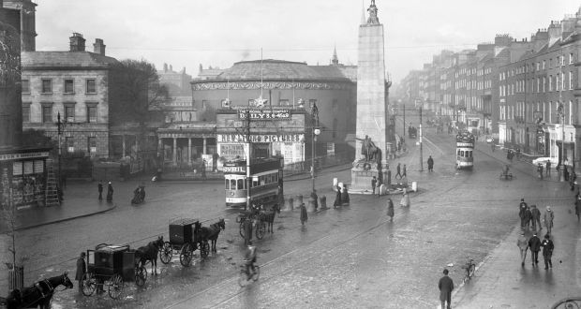
Early Life
Originally supposed to be a priest
Soldier in WW1
Traveled abroad
Tons of new jobs and experiences
After workers riot Exiled to England where he began his career

Slide 4
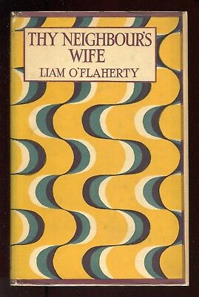
Career
Edward Garnett guided O’Flaherty
Returned to Dublin and married Margaret Barrington
First novel – “Thy Neighbour’s Wife”
Wrote consistently till 1950 then went silent

Slide 5
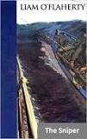
Famous and influential Works
Lyrical stories
  “Spring Snowing” (1926)
  “Two Lovely Beasts and Other Stories” (1948)
Novels
  “The Informer” (1926)
  “Skerrett” (1932)
  “Famine” (1937)

Slide 6
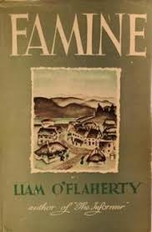
Personal struggles
Shell shock from WW1 France
Mental Breakdowns
Gap between himself and Ireland

Slide 7
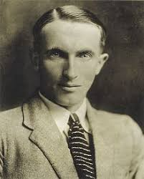
Irish nationalism
Irish Renaissance
Wrote of Irish struggle for freedom
Examined and nourished Irish culture

Slide 8


Controversy in life and death
Founder of the Irish Communist Party
Writings originally banned in Ireland but now studied in Irish schools
Critics after his death said he “romanticized violence”

Slide 9
Works Cited
Berger, Joseph. “WROTE TALES OF IRISH STRUGGLE.” The New York Times, The New York Times, 9 Sept. 1984, www.nytimes.com/1984/09/09/obituaries/liam-o-flaherty-dies-at-88-wrote-tales-of-irish-struggle.html.
The Editors of Encyclopaedia Britannica. “Liam O'Flaherty.” Encyclopædia Britannica, Encyclopædia Britannica, Inc., 19 Nov. 2019, www.britannica.com/biography/Liam-OFlaherty.
Farrell, Jenny, and Liam O'Flaherty. “'The Discarded Soldier' by Liam O'Flaherty, a Rediscovered Anti-War Short Story.” The Irish Times, The Irish Times, 6 Dec. 2018, www.irishtimes.com/culture/books/the-discarded-soldier-by-liam-o-flaherty-a-rediscovered-anti-war-short-story-1.3721254.

