Slide 1

Playing In the Dark: WHITENESS AND THE LITERARY IMAGINATION
Jemel Jones

Slide 2
About Toni Morrison
Born in Lorain, Ohio on February 18, 1931
Group up having a passion for black culture
Had a passion for storytelling as a kid
Central theme of her novels is the African American experience

Slide 3
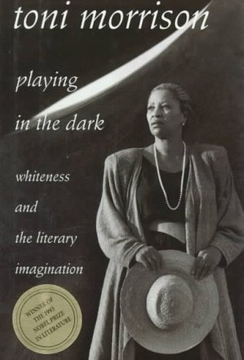
Playing in the dark
OVERVIEW

Slide 4
Playing in the dark
ANALYSIS

Slide 5
THOUGHTS
Uses great evidence to back up her claims
Able to connect on a personal level.
Forces her readers to have an open mind

Slide 6
Discussion question
Do you feel that Toni Morrison is correct in her assumptions about American literature and did she do a good job in portraying the issue at hand?

Slide 7
Works cited
“Playing in the Dark.” Playing in the Dark, blog.englishusingsongs.com/index.php/book-reviews/ba-in-english/african-american-studies/toni-morrison/129-playing-in-the-dark.
The Editors of Encyclopaedia Britannica. “Toni Morrison.” Encyclopædia Britannica, Encyclopædia Britannica, Inc., 14 Feb. 2020, www.britannica.com/biography/Toni-Morrison.

