Slide 1
The sniper- Liam O’Flaherty
CDT Kate Fellows

Slide 2
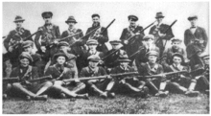

Context
Irish Civil War
The author: O’Flaherty was a member of the Communist Party and a Republican soldier

Slide 3
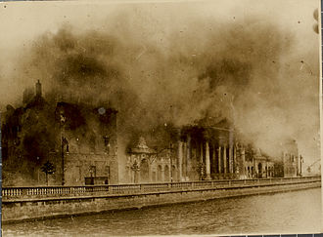
Summary
Irish Civil War, Dublin
Two snipers on opposite roofs
Sniper reveals his location and is shot at
Sniper shoots at enemy vehicle
Sniper plays dead to give false confidence to the enemy sniper
Sniper shoots and kills enemy sniper
Sniper finds out enemy sniper was his brother

Slide 4
Theme- Destruction of War
Shows that violence tears apart families
Actions during war like human
Every soldier has a life separate from war

Slide 5
Theme- Internal Struggle
When he discovers it was his brother it is almost as if he was fighting himself
Snipers are mentally disciplined to overcome fatigue, hunger, etc.

Slide 6
Works Cited
“Irish Civil War.” Wikipedia, Wikimedia Foundation, 23 Mar. 2020,
  en.wikipedia.org/wiki/Irish_Civil_War.
“The Sniper--Liam O'Flaherty (1897-1984).” Classic Short Stories, www.classicshorts.com/stories/sniper.html.
“The Sniper.” Short Stories for Students, Encyclopedia.com, 2 Apr. 2020,
  www.encyclopedia.com/education/news-wires-white-papers-and- books/sniper#Author_Biography.

