Slide 1

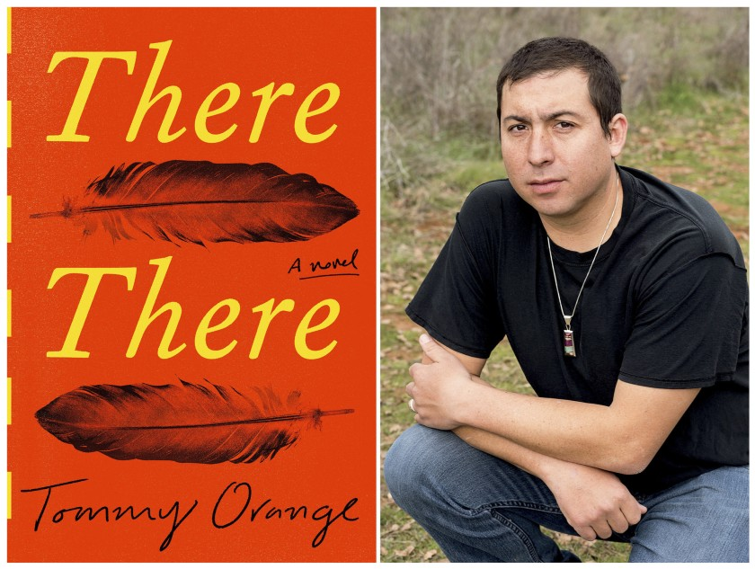

Tommy Orange
CDT Madeline Magoto

Slide 2
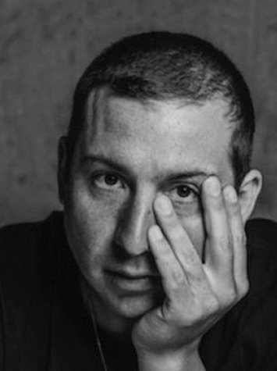
Early life
Born January 19, 1982 in Oakland, California
Orange's mother is white, and his father is Cheyenne.
member of the Cheyenne and Arapaho Tribes of Oklahoma
Institute of American Indian Arts MFA program, where he now teaches

Slide 3
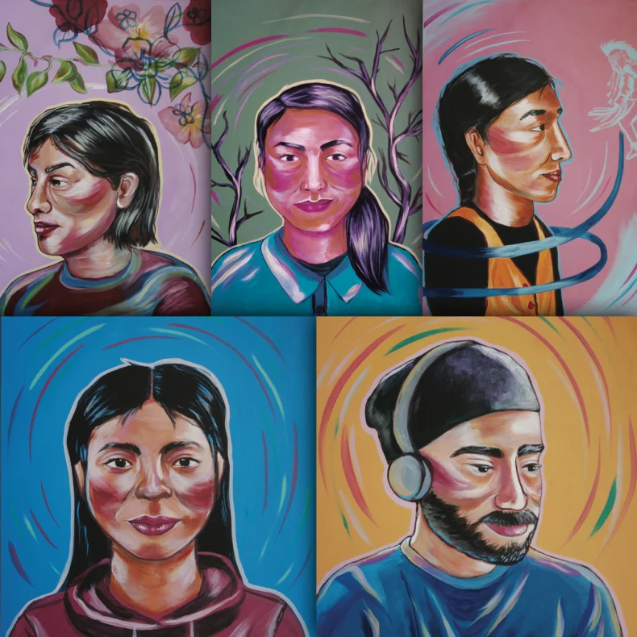
Themes
Native Americans living in the area of Oakland, California
Cultural Identity vs. Personal Identity
Generational Trauma
Depression, alcoholism, unemployment, fetal alcohol syndrome

Slide 4
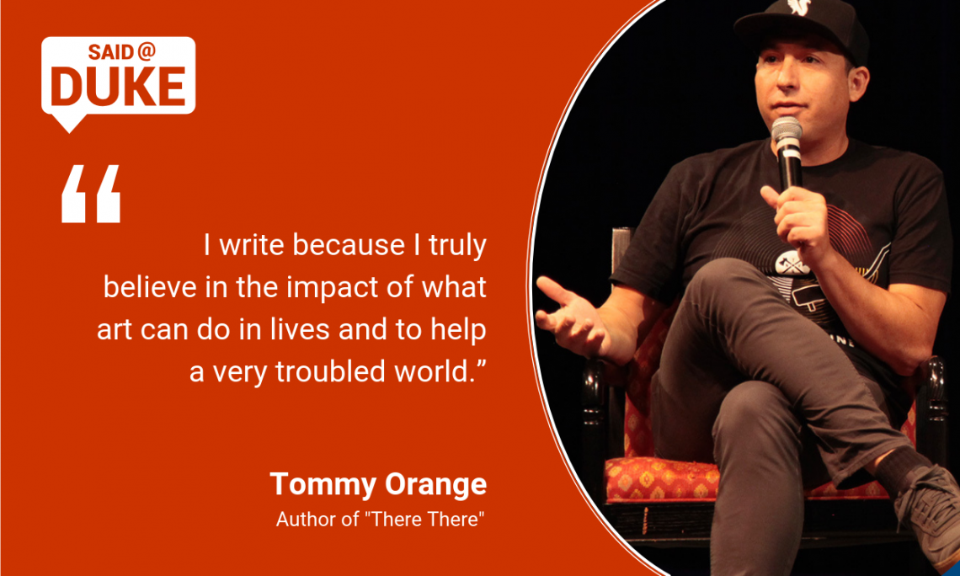
Awards
President Obama’s favorite things list
Finalist for a Pulitzer Prize
National Book Critics Circle Award
2019 Hemingway Foundation/PEN Award

Slide 5
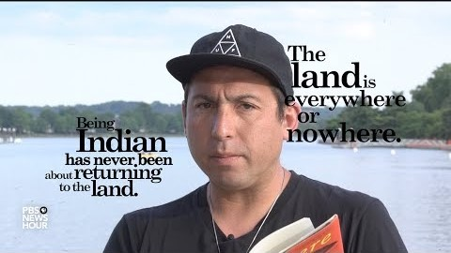
A deeper look

Slide 6
Sources
“Native American Author Tommy Orange Feels A 'Burden To Set The Record Straight’.” NPR, WGTE, 8 June 2020, https://www.npr.org/2018/06/08/ 617604580/native-american-author-tommy-orange-feels-a-burden-to-set -the-record-straight
“There There (novel).” Wikipedia, Wikipedia, 20 March 2020, https://en. wikipedia. org/wiki/There_There_(novel)#Themes

