Slide 1

Mark Twain
By: Nick Kramer

Slide 2


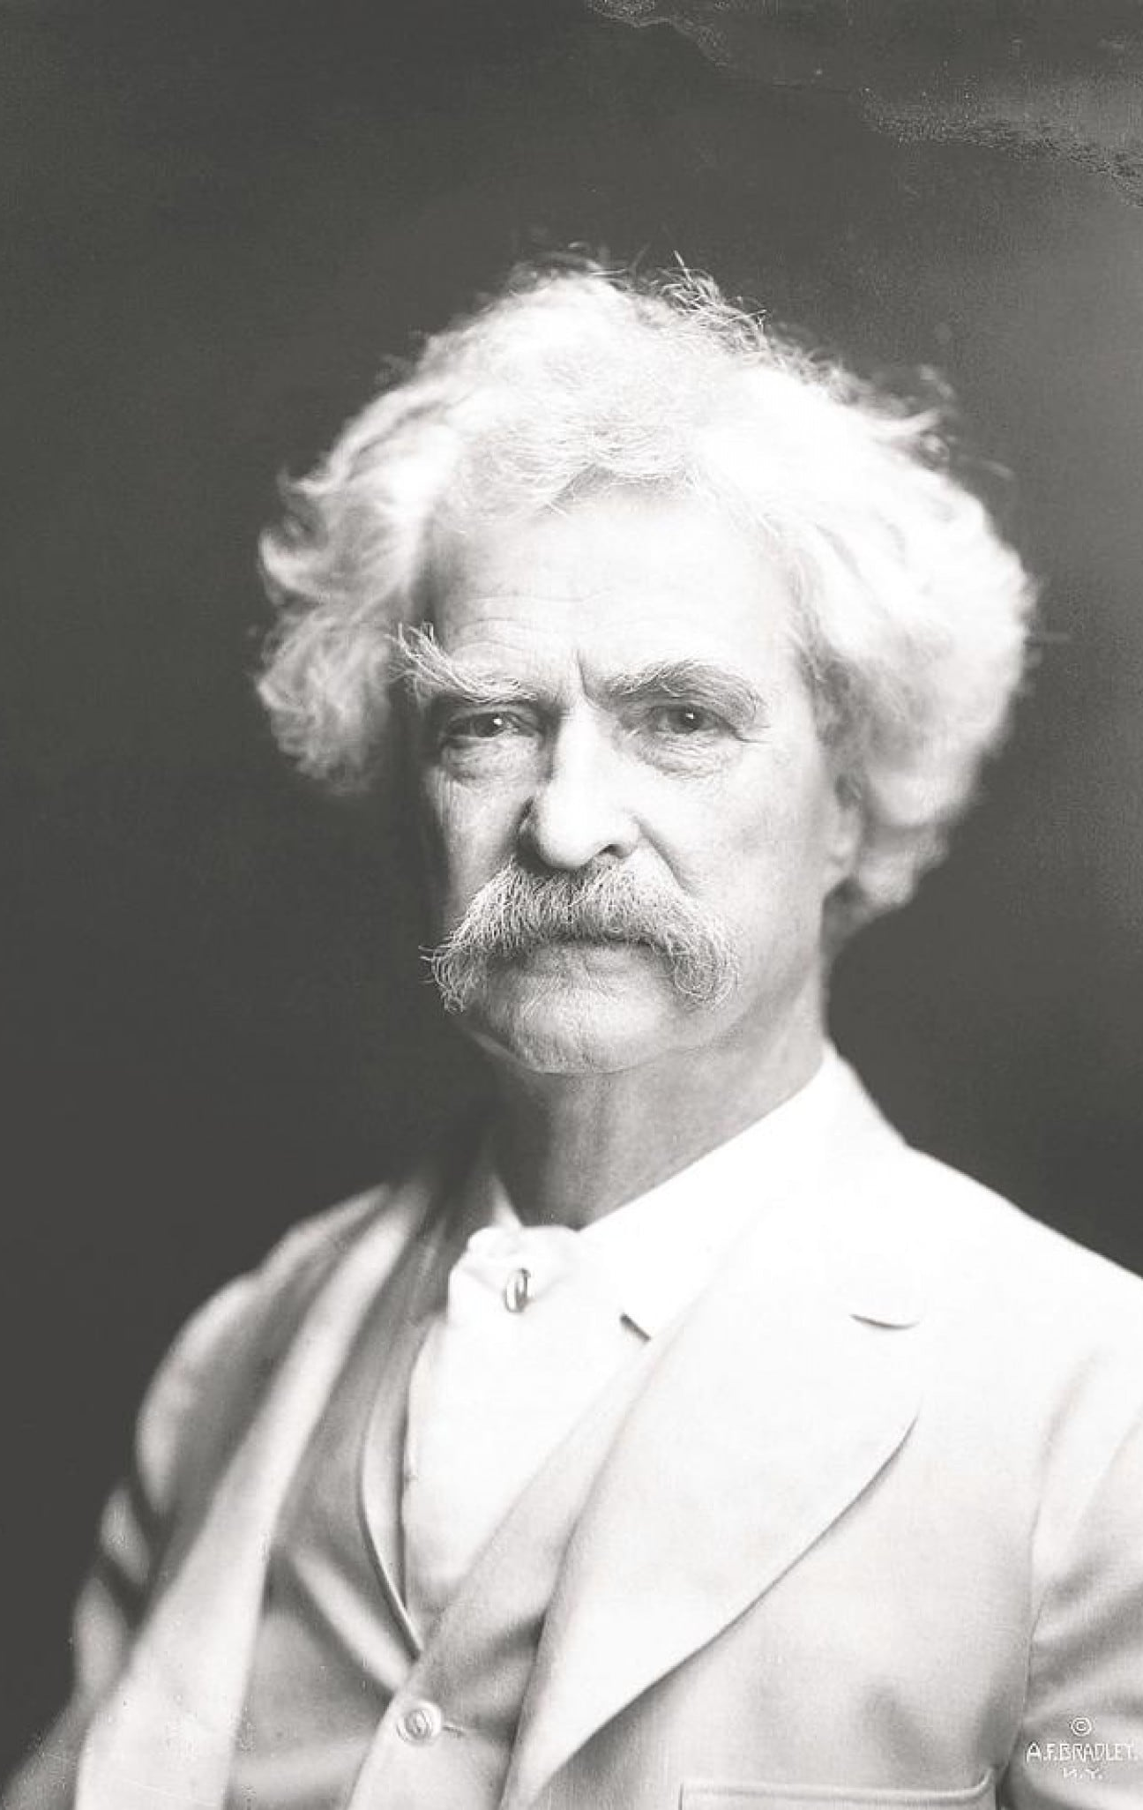

Biographical Information
Mark Twain (Samuel Clemens)
Born: November 30th, 1835 Died: April 21st, 1910
- Born 6/7 children in Florida, Miss.
Became a Steamboat Pilot on the Mississippi River
Traveled across the country, found inspiration for his writings
Was a miner in Nevada, writer, inventor and investor

Slide 3
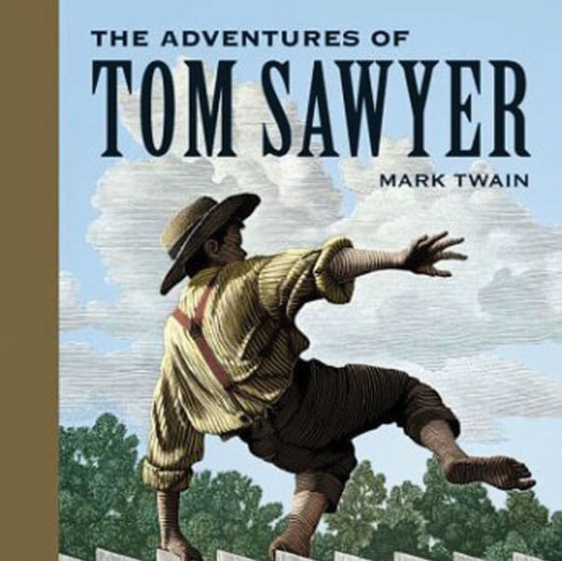
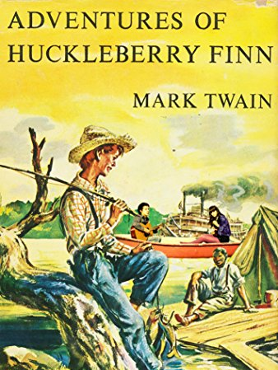
Notable Works
The Adventures of Tom Sawyer (1876)
Based on his childhood in Hannibal, Missouri, characters based off childhood friends
The Adventures of Huckleberry Finn (1884/1885)
Story of Huck Finn, recurring character in other novels, traveling along the Mississippi, describes regions colorfully using vernacular language
Called first great American novel, commonly banned by schools
Life on the Mississippi (1883), personal memoir, considered eye opening as it illustrates life along Mississippi river
Many other works failed to gain acclaim (The Prince and the Pauper, A Tramp Abroad, Personal Recollections of Joan of Arc, etc.)

Slide 4
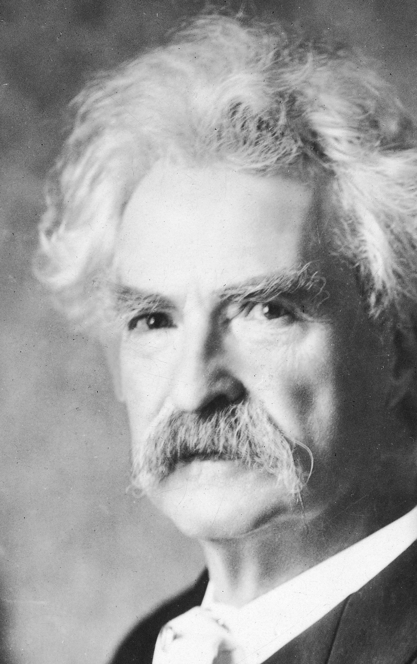
Significance of Works
Use of plain language, regionally and historically accurate vernaculars
Works were authentic, as based on his own experiences
Emphasized national issues such as slavery, class barriers, disregard of rural areas by the nation at large
Works teach right from wrong, love of country, and bring light to forgotten parts of the country
Huck Finn is considered the best piece and the base for all American literature
Works such as The Adventures of Tom Sawyer and The Adventures of Huckleberry Finn have fostered debates on censorship in the 21st century

Slide 5

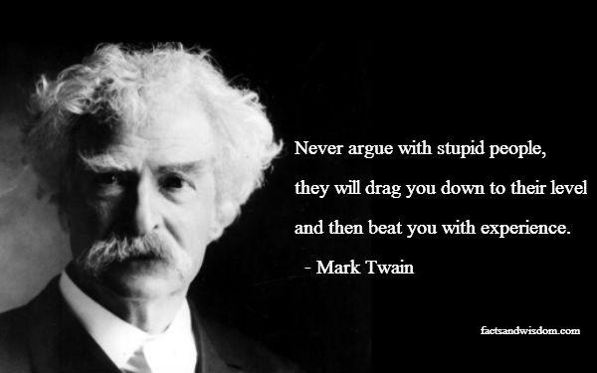


Satire
Known for use of satire and quips in both his novels, and in everyday life.

Slide 6
Works Cited
Moss, George. “Why Is Mark Twain Still so Important Today?” Why Is Mark Twain Still so Important Today? I Oxford Open Learning, 26 Nov. 2018, 10:00 AM, www.ool.co.uk/blog/why-is-mark-twain-still-so-important-today/.
Hunter, Poem. “Mark Twain.” Pintrest, www.pinterest.com/pin/28217935148829823/.
Petsko, Emily. “11 Fascinating Facts About Mark Twain.” Mental Floss, 28 Aug. 2019, www.mentalfloss.com/article/565150/mark-twain-books-facts.
Petri, Alexandra. “Mark Twain, American Classic.” The Washington Post, WP Company, 30 Nov. 2011, www.washingtonpost.com/blogs/compost/post/mark-twain-american-classic/2011/11/30/gIQAcTMLDO_blog.html.
Quirk, Thomas V. “Literary Maturity.” Encyclopædia Britannica, Encyclopædia Britannica, Inc., 11 Nov. 2019, www.britannica.com/biography/Mark-Twain/Literary-maturity.
“The Adventures of Tom Sawyer.” Memoria Press, www.memoriapress.com/curriculum/literature-and-poetry/the-adventures-of-tom-sawyer/.
“The Adventures of Huckleberry Finn.” Amazon, www.amazon.com/Adventures-Huckleberry-Finn-Annotated-ebook/dp/B06XP3YQNT.

