Slide 1
Toni morrison
“Playing In The Dark”
CDT Olaf koryciak

Slide 2

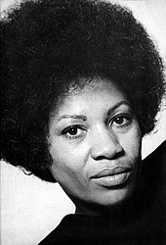
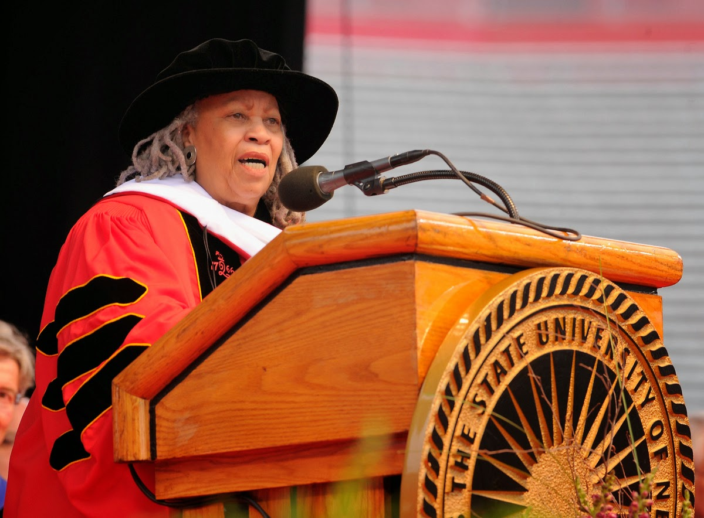
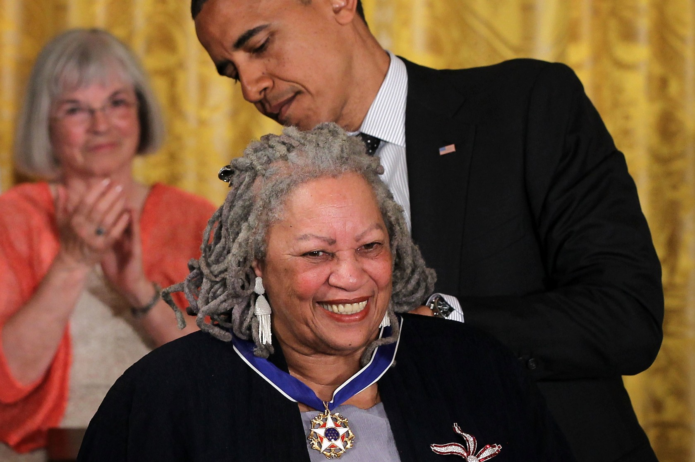
aBout the author
Background
Education
Career

Slide 3




”Black matters” in “Playing In The Dark”
INFORMATION
MAIN POINT
STATEMENTS
FINAL COMMENTS

Slide 4
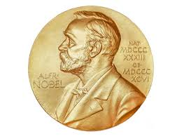

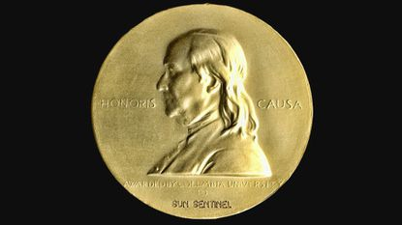
Well known books
Awards and honors

Slide 5

Questions

Slide 6
Works cited
Morrison, Toni. Playing in the Dark: Whitness and the Literary Imagination. First Vintage Books Edition, 1992.
The Editors of Encyclopaedia Britannica. “Toni Morrison.” Encyclopædia Britannica, Encyclopædia. Britannica, Inc., 14 Feb. 2020, www.britannica.com/biography/Toni-Morrison.

