Slide 1
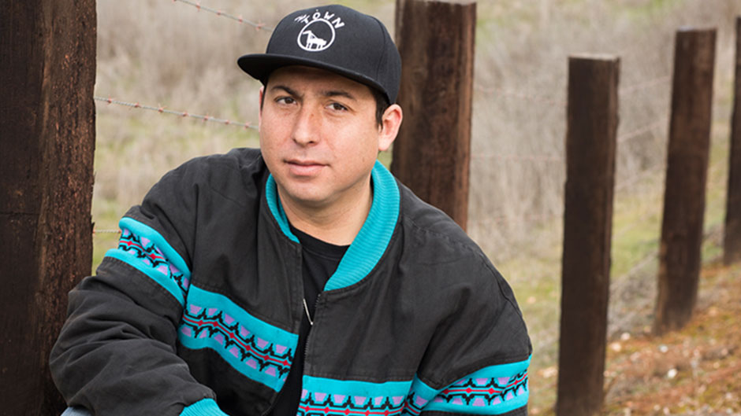
Tommy Orange
By sean dwyer

Slide 2
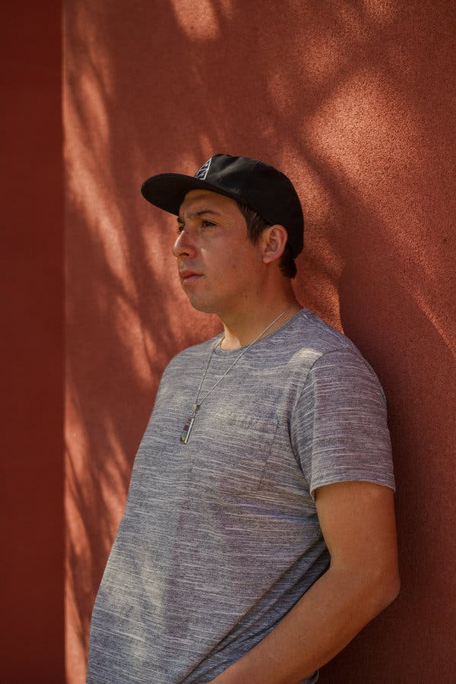
General Information:
Born January 19, 1982
Grew up in Oakland, CA
Member of the Cheyenne and Arapaho Native American tribes

Slide 3
Early Life:
His father, who spoke Cheyenne as his first language, was a Native American church ceremony leader.
His mother converted to evangelical Christianity and denounced his father’s faith.
This lead Orange to feeling like he never belonged in either world.
Orange spent most of his childhood trying to figure out what he belived.

Slide 4
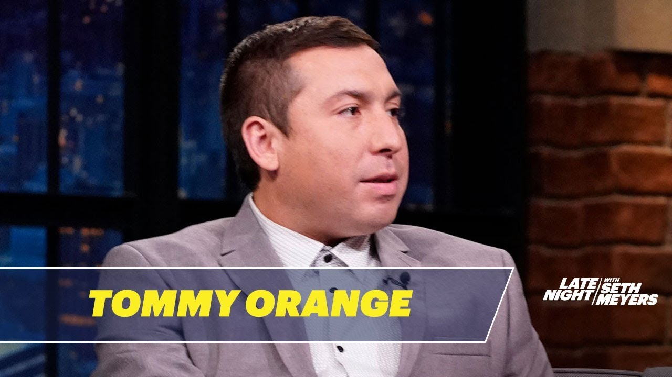
Adulthood:
Graduated from the MFA program at the Institute of American Indian Arts.
Started his writing career by writing articles for magazines and newspapers to gain a bit of money.
He used many of the experiences he had from writing his articles to help him write There, There.

Slide 5
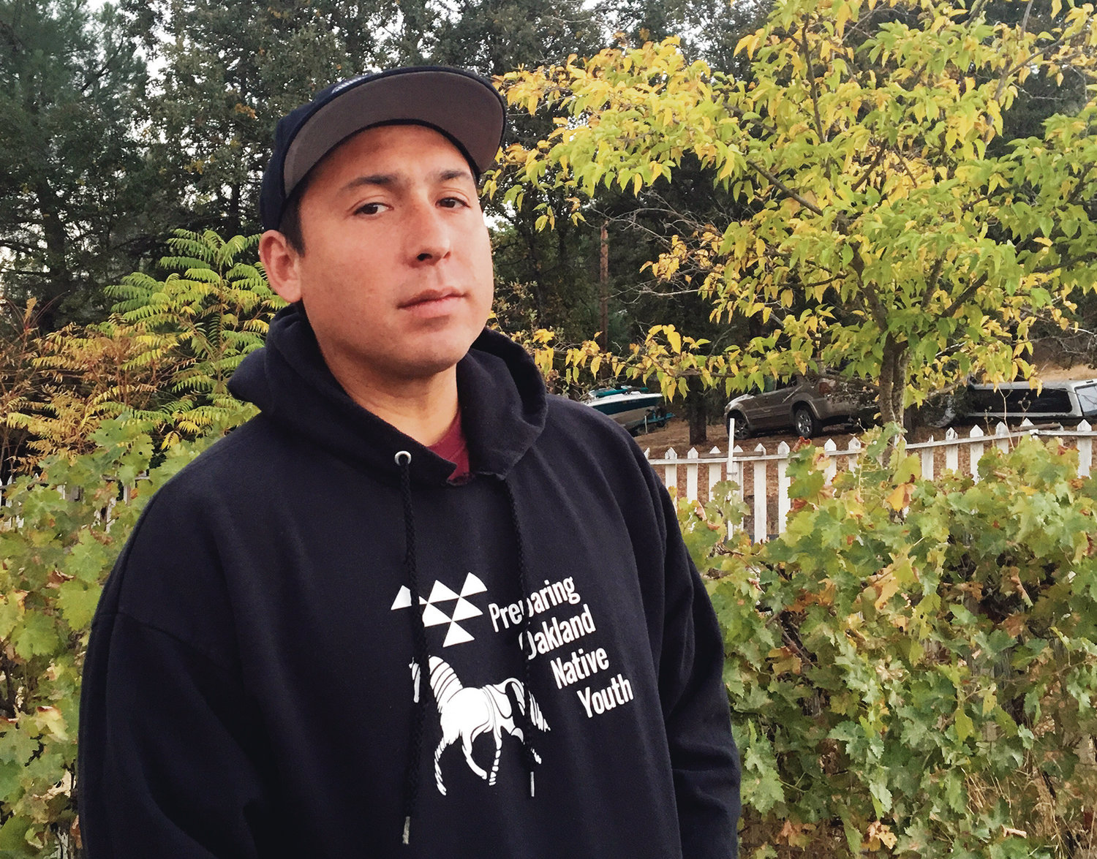
New Native Writers:
Orange is part of a new generation of acclaimed indigenous writers from the United States and Canada.
This new generation is publishing poetry, fiction and prose that shatter old stereotypes about Native American literature, experience and identity.

Slide 6
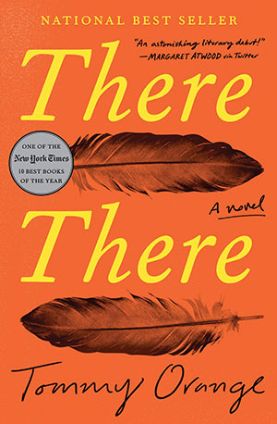
Famous Works:
At the moment the only book Orange has written is There, There, but he is currently working on a sequel to it.

Slide 7
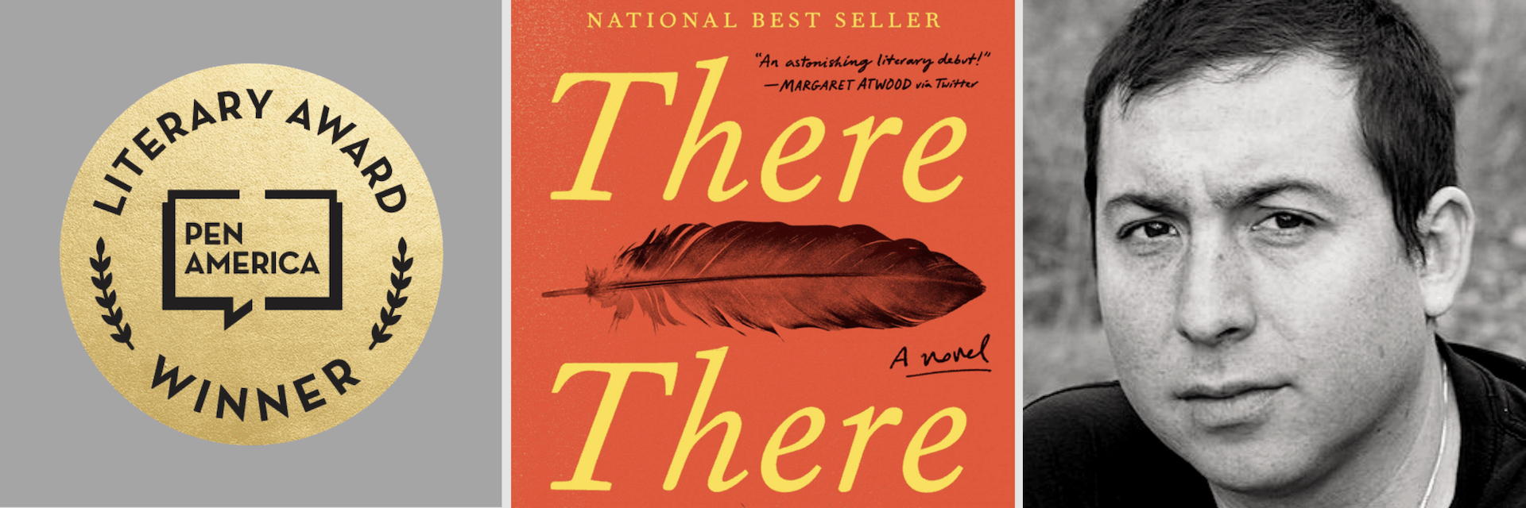
Awards Won:
The 2018 National Book Critics Circle Award
The 2019 Hemingway Foundation/PEN Award
The Center for Fiction First Novel Prize
An American Book Award

Slide 8
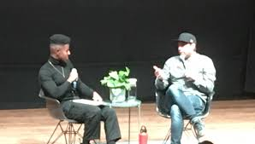
Today:
Tommy still continues to write today.
Although he is on the road a lot, he does it all with his wife, Kateri, and their young son by his side.

Slide 9
Works Cited:
Alter, Alexandra. “Tommy Orange's 'There There' Is a New Kind of American Epic.” The New York Times, The New York Times, 31 May 2018, www.nytimes.com/2018/05/31/books/tommy-orange-there-there-native-american.html.
Orange, Tommy. “There There by Tommy Orange: 9780525436140: PenguinRandomHouse.com: Books.” PenguinRandomhouse.com, Knopf, www.penguinrandomhouse.com/books/563403/there-there-by-tommy-orange/.
Ruland, Jim. “Tommy Orange Adjusts to All the Attention as a 'There There' Sequel Flows Along.” Los Angeles Times, Los Angeles Times, 21 Nov. 2019, www.latimes.com/entertainment-arts/books/story/2019-11-21/tommy-orange-there-there-sequel.

