Slide 1

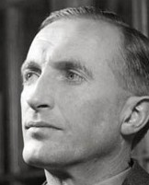


Liam O'Flaherty
(1896-1984)
Presentation of the Author
By CDT Theodore Mayer

Slide 2
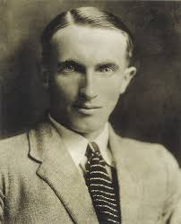

Early Life
Born August 28th, 1896 on the rugged Aran Island Inishmore.
Grew up in a poor Irish family.
His family was anti-clerical, but priesthood was the only way for young Liam to get an education.
Studied at Rockwell College, Blackrock College, and the University of Dublin
Abandoned his studies to join the Irish Guards in 1915.

Slide 3
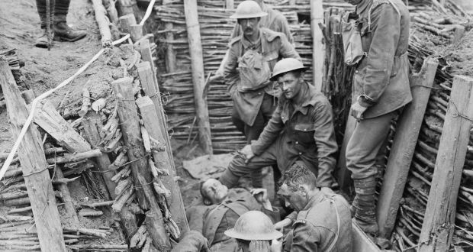
World War I
Enlisted under the name of “Bill Ganly.”
Injured in 1917 by an artillery shell and hospitalized for shell shock.
Suffered two nervous breakdowns after the war as a result of his PTSD.
His anti-war literature such as The Sniper was inspired by his experiences in WWI and the Irish Civil War.

Slide 4

The World Traveler
After the war, O’Flaherty traveled to South America, Turkey, and Canada.
He then ventured to America and joined the communist party.
In 1921, he returned to Ireland during the Irish Civil War.
He became briefly involved with a socialist radical group during the violence.
He fled the violence for London where he began writing fervently.

Slide 5
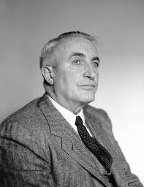
The Emerging Writer
In London, he wrote his first play in Irish/Gaelic, but it was a flop.
Liam decided to began writing in English instead of Irish.
Literary experts accredit his novel’s vivid imagery and detailed settings to Gaelic being his first language.
In 1923, he wrote his first novel, Thy Neighbor’s Wife.

Slide 6
The Eternal Nomad
During his writing career, O’Flaherty divided his time between America, Ireland, England, and France.
In 1926, he married his first wife Margaret Barrington, but they split in 1932.
In 1937 he married Kitty Taylor and continued to travel and write.
Finally, he retired in Dublin in 1952 and died there on September 7, 1984.
The letters he wrote during his travels were widely published after his death.

Slide 7
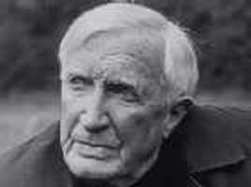
Major Works
O’Flaherty produced the majority of his work from 1923-1952.
These include:
  Thy Neighbor’s Wife (1923)
  The Sniper (1923)
  The Informer (1924)
  The Black Soul (1924)
  The Short Stories of Liam O'Flaherty (1937)
  The Assassin (1928)
  Skerrett (1932)
  Famine (1937)
The Informer was later transformed into a film by his cousin John Ford.

Slide 8
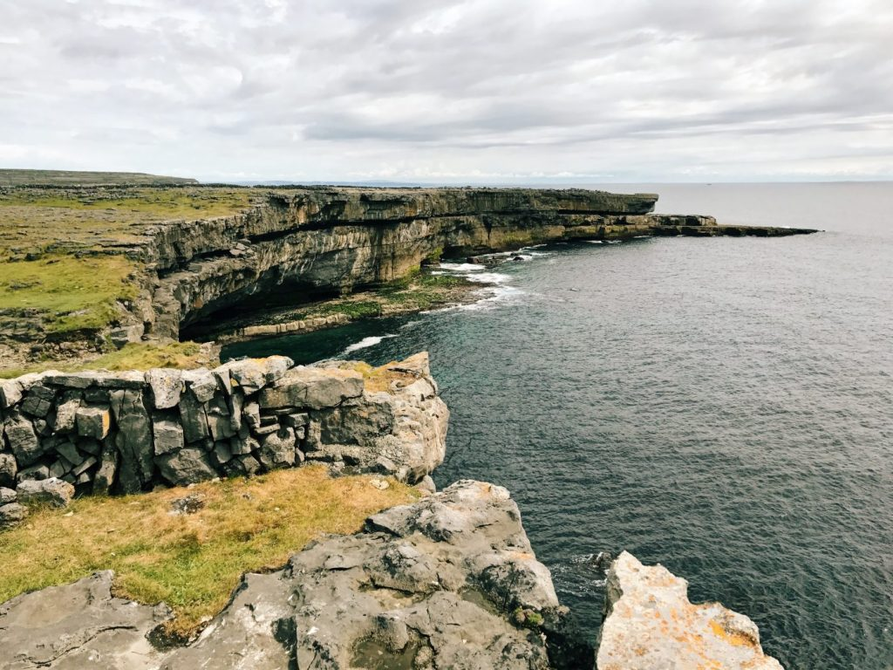
“I was born on a storm-swept rock and hate the soft growth of sunbaked lands where there is no frost in men’s bones.“ -Liam O’Flaherty

Slide 9
Works Cited
Haggerty, Bridget. “A Tribute to Liam O’Flaherty.” Irish Customs and Cultures, https://www.irishcultureandcustoms.com/AWriters/LiamOFlaherty.html. Accessed 3 April 2020.
Johnson, Megan. “Liam O’Flaherty’s ‘The Sniper’ and the Irish Civil War.” Florida State University, https://wr.english.fsu.edu/College-Composition/Our-Own-Words-The-James-M.-McCrimmon-Award/Our-Own-Words-2008-2009-Edition/Liam-O-Flaherty-s-The-Sniper-and-the-Irish-Civil-War-by-Megan-Johnson. Accessed 3 April 2020.
“Liam O’Flaherty.” Bloomsbury, https://www.bloomsbury.com/author/liam-oflaherty. Accessed 3 April 2020.
“Liam O’Flaherty.” County Galway Guide, http://aranislands.galway-ireland.ie/liam-oflaherty.htm. Accessed 3 April 2020.
“Liam O’Flaherty.” Irish Paris, http://www.irishmeninparis.org/writers-and-journalists/liam-o-flaherty. Accessed 3 April 2020.

