Slide 1

There There
Introduction
By: CDT Noah Watkins

Slide 2
Background
Written by Tommy Orange, a member of the Cheyenne and Arapaho tribes based in Oklahoma
Novel centered around modern-day Native Americans in Oakland, California
Novel contains many characters who rotate as the role of narrator
Many possible themes

Slide 3
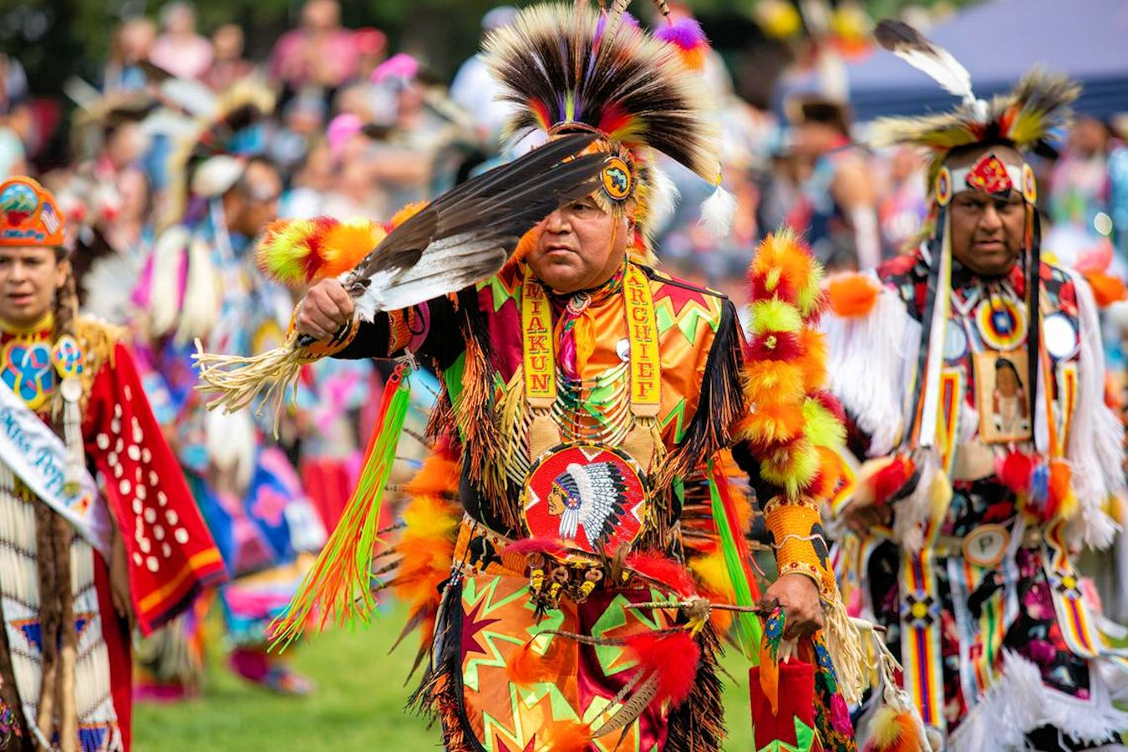
Context
Modern-day Native Americans on their way to the powwow in Oakland, California
Characters have different backgrounds and expectations regarding this powwow
Fictional “Big Oakland Powwow”

Slide 4
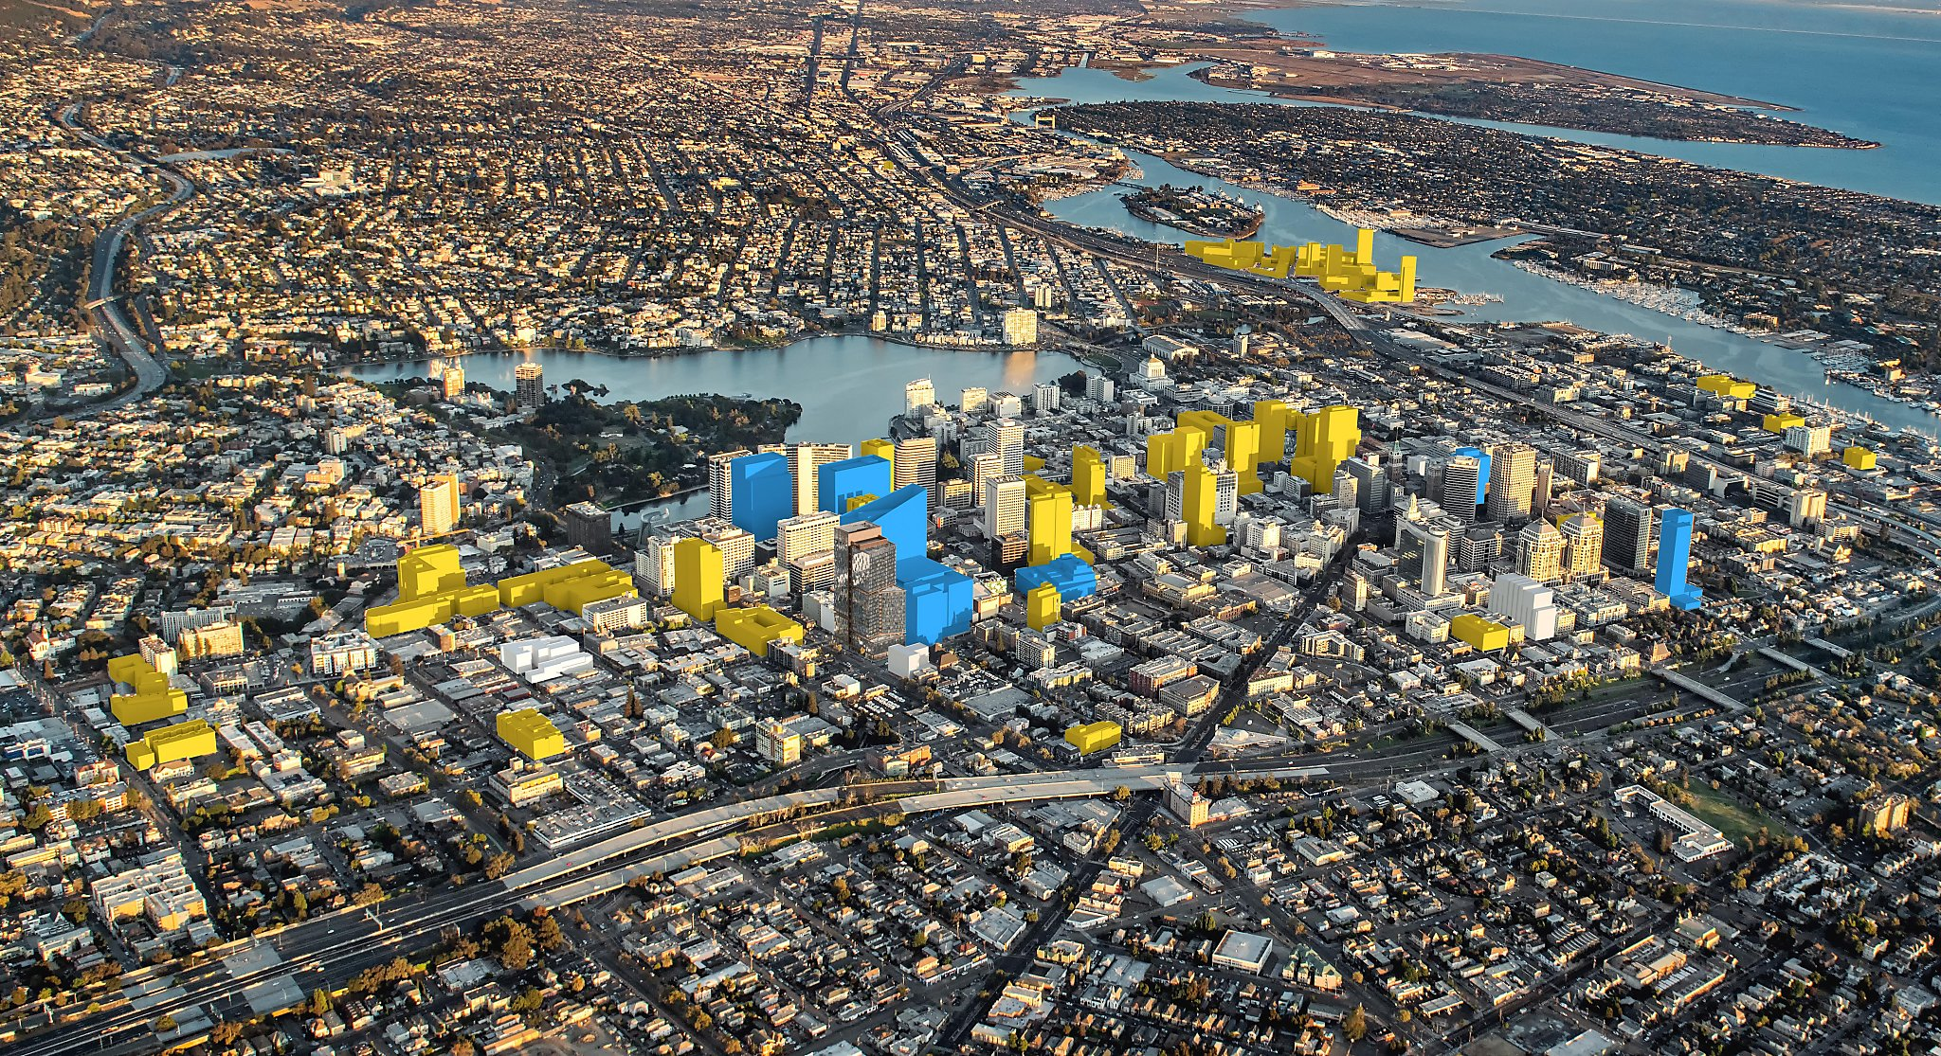
Oakland
Oakland, California
Located in San Francisco
Notorious for high crime rates and gang violence

Slide 5
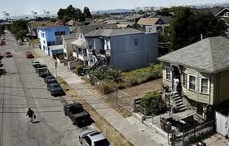

Slide 6
Prologue
Stories of atrocities committed against Native Americans in the early colonial period of what now is the United States
Tie back into modern-day Native Americans living in Oakland in a different culture altogether

Slide 7
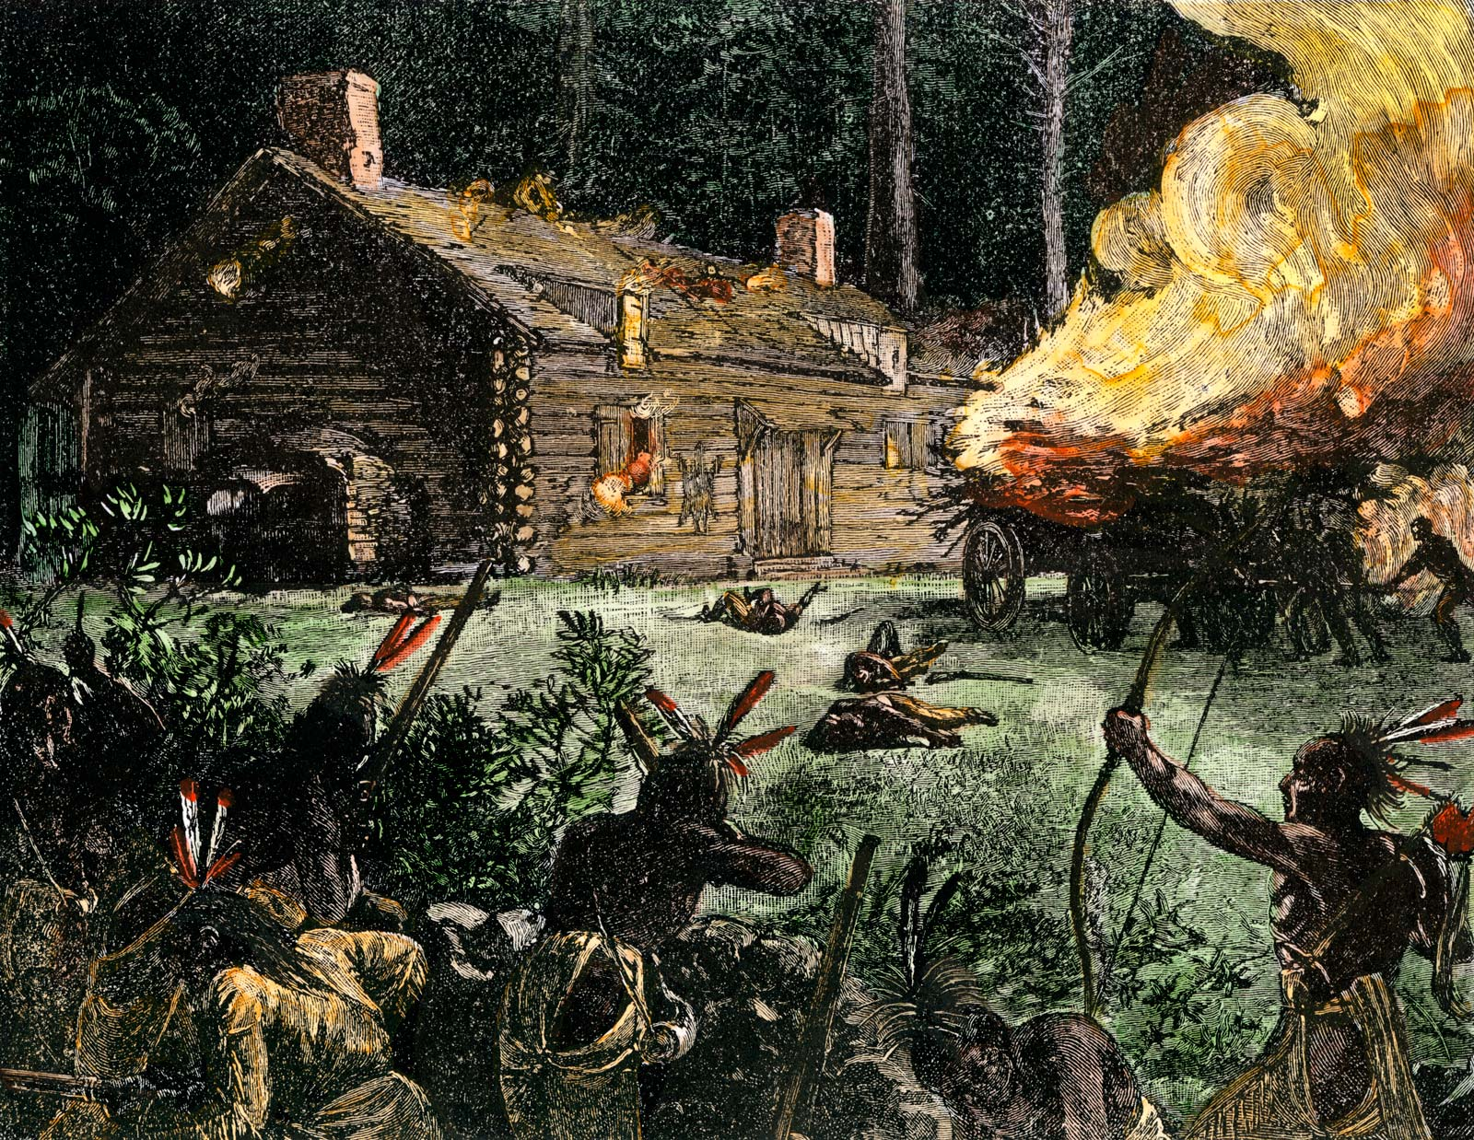
Prologue
Land-deal feast between colonists and Wampanoags
Two years later, another feast mysteriously ends with two hundred Native Americans dying from poison
Metacomet’s treaty led to King Philip’s War
Native Americans massacred and their body parts were kept as trophies

Slide 8
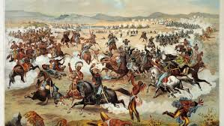

Slide 9
Works Cited
Buchanan, Rowan. “There There by Tommy Orange review – Native American stories.” The Guardian, 18 Jul. 2018. https://www.theguardian.com/books/2018/jul/18/there-there-tommy-orange-review. Accessed 12 April 2020.
Larman, Alexander. “There There by Tommy Orange review – moving and powerful.” The Guardian, 15 Jul. 2018. https://www.theguardian.com/books/2018/jul/15/there-there-tommy-orange-review. Accessed 12 April 2020.
Orange, Tommy. There There. Vintage Books, 2018.

