Slide 1

There There by Tommy Orange
Public reception and perception
Presented by: CDT Zachary Hines

Slide 2
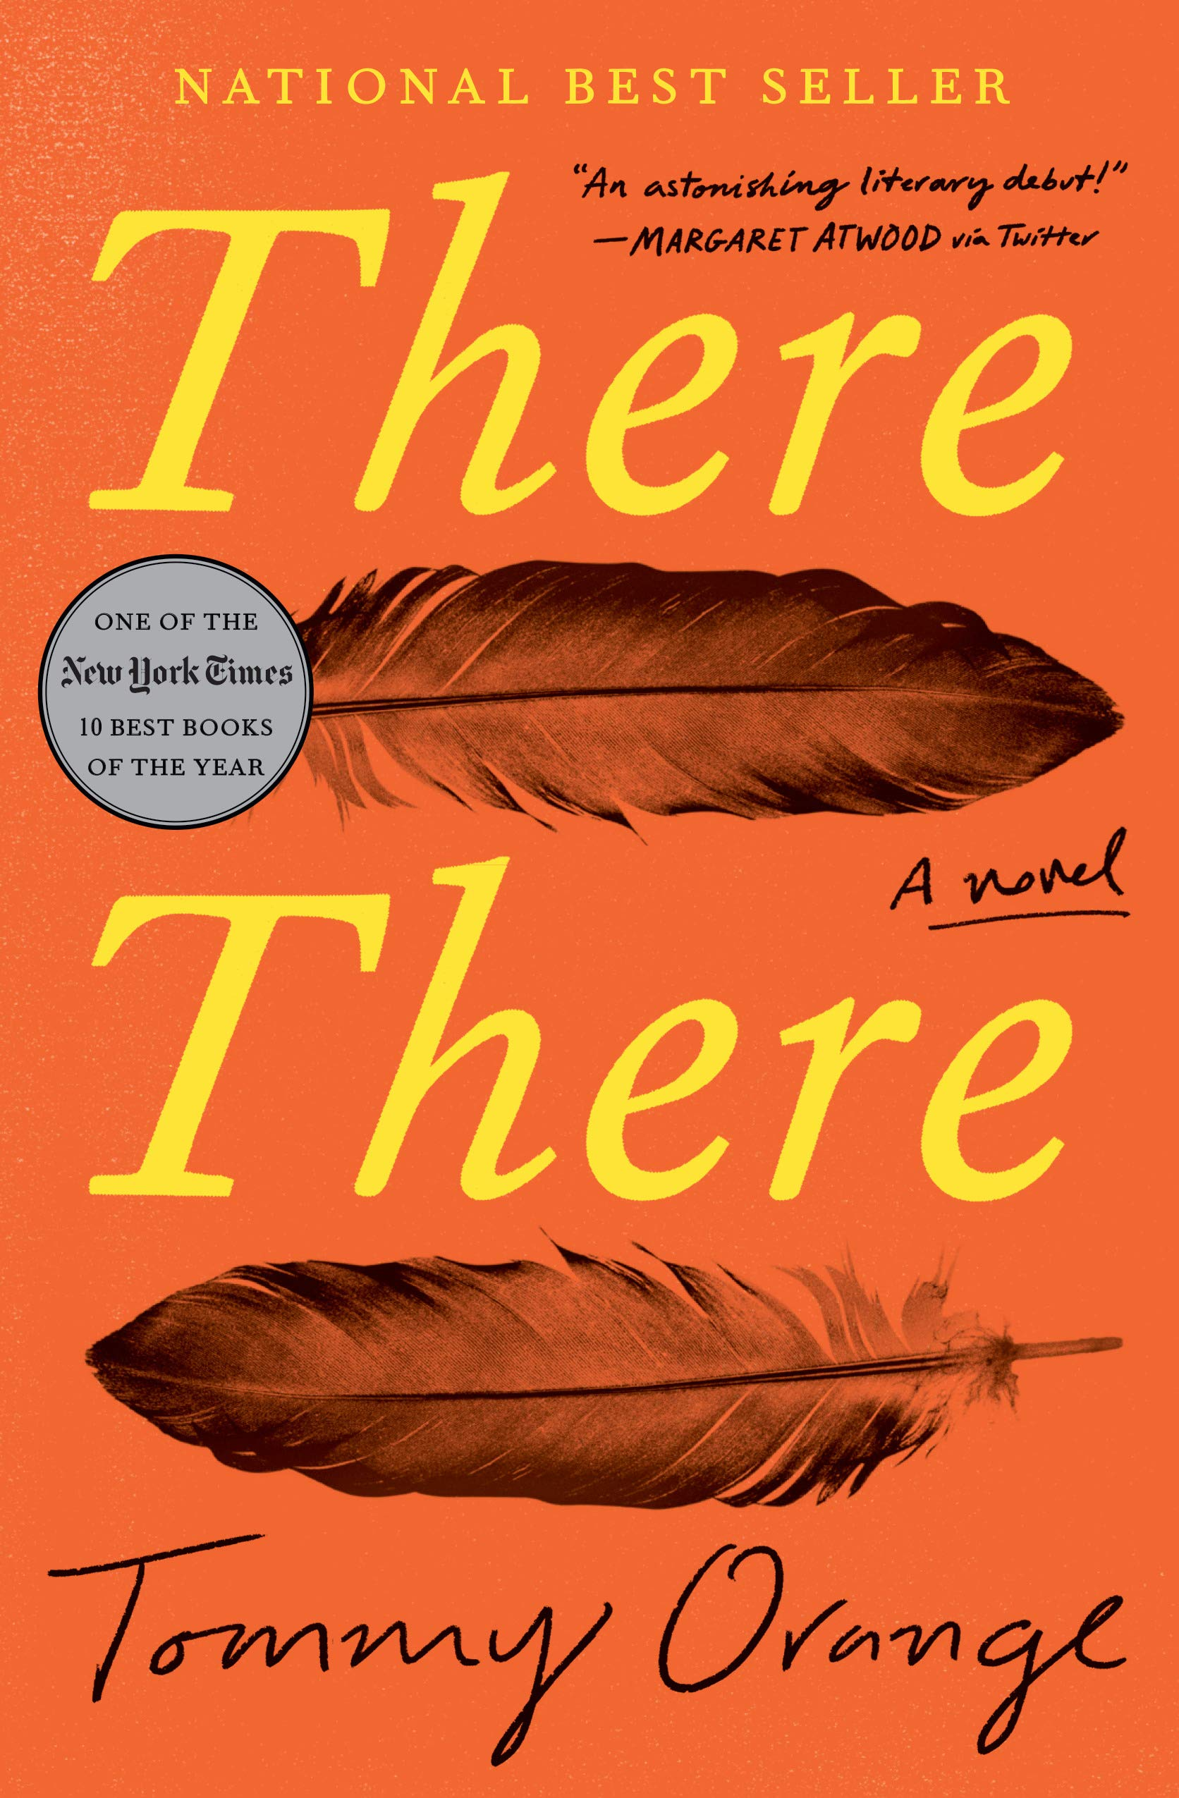
General Information:
Released in 2018
Written by Tommy Orange, who is of Native heritage and grew up in Oakland
Tells the stories of urban Indians living in and around Oakland, California
Written to reveal Native stories, especially those of urban Indians, to a broader audience
Contains many different characters and points of view in order to provide a wholistic perspective on urban Indian identity

Slide 3

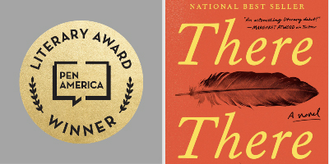
Commercial success and awards:
#8 on New York Times Bestseller list
#1 on San Francisco Chronicle best seller list
PEN/Hemmingway award for fiction novels in 2019
John Leonard prize 2018
American Book Award for Literary Achievement
Center for Fiction First Novel Prize 2018
Nominated for a Pulitzer prize
Overall positive reception

Slide 4



Prologue and urban-Indian mindset:
Indian Appropriation Act limits tribal land to reservations spread throughout the United States, which forms public views on the lives of modern Native Americans.
“We did not move to cities to die. The sidewalks and streets, the concrete absorbed our heaviness. The glass, metal, rubber, and wires, the speed, the hurtling masses — the city took us in.” –Tommy Orange
They hold onto the belief that the city and its contents are of the Earth, and have importance under native tradition.
vs.

Slide 5



Native American life is associated with reservations, wilderness, and traditional values.
Urban Indians chose a life outside the reservations.
Characters in the novel act as paradoxes that go against commonly held views on Native life.
“We are the memories we don’t remember,” he writes. “We know the sound of the freeway better than we do rivers.” –Tommy Orange
Forgotten Urban Indian Voices:

Slide 6
Conclusion
There There by Tommy Orange alters public perception of the Native American community as a whole by introducing us to the lives of urban Indians, who hold onto aspects of their culture while living a non traditional way of life.

Slide 7
Sources:
“There There by Tommy Orange.” Goodreads, Goodreads, 5 June 2018, www.goodreads.com/book/show/36692478-there-there.
Toibin, Colm. “Yes, Tommy Orange's New Novel Really Is That Good.” The New York Times, The New York Times, 19 June 2018, www.nytimes.com/2018/06/19/books/review/tommy-orange-there-there.html?searchResultPosition=2.
Orange, Tommy. There There. Emblem Editions, 2020.
Ruland, Jim. “Tommy Orange Adjusts to All the Attention as a 'There There' Sequel Flows Along.” Los Angeles Times, Los Angeles Times, 21 Nov. 2019, www.latimes.com/entertainment-arts/books/story/2019-11-21/tommy-orange-there-there-sequel.

