Slide 1


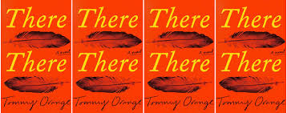
There There by Tommy Orange
The Reception
of
This Photo by Unknown Author is licensed under CC BY

Slide 2
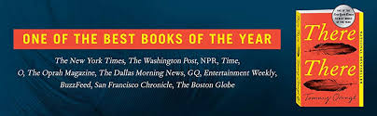

PRAISE
“Masterful…White-hot…Devastating” –The Washington Post
“Tommy Oranges There There is simply amazing! Yes, its heartbreaking, but Oranges multigenerational story of the urban Native American experience is unforgettable. There are 12 distinct voices shaping the story, but they all resonate and feel bound together and drive the narrative forward.” –JL Sutton
This Photo by Unknown Author is licensed under CC BY-ND
“Gripping….Unforgettable….There There paints a vivid portrait of American lives few readers have ever known” -Bustle
“Poweful…There There has so much jangling energy and brings so much news from a distinct corner of American life that it’s a revelation.”-The New York Times

Slide 3


CRITIQUES
“Too many characters…”-Catherine
The preface and beginning was a solid five star. I was impressed. But then we get short stories of the worst traumas of many, loosely connected people, none of whom we get to know well. -Marta
This Photo by Unknown Author is licensed under CC BY-SA
“The individual stories didn’t either engage me or really have anything significant to say, and there are so many of them, so many different characters who are all secretly bound together, all heading off to the powwow”-Roman Clodia
This Photo by Unknown Author is licensed under CC BY-SA

Slide 4
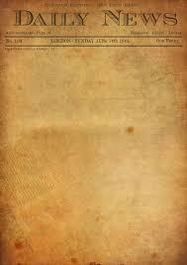

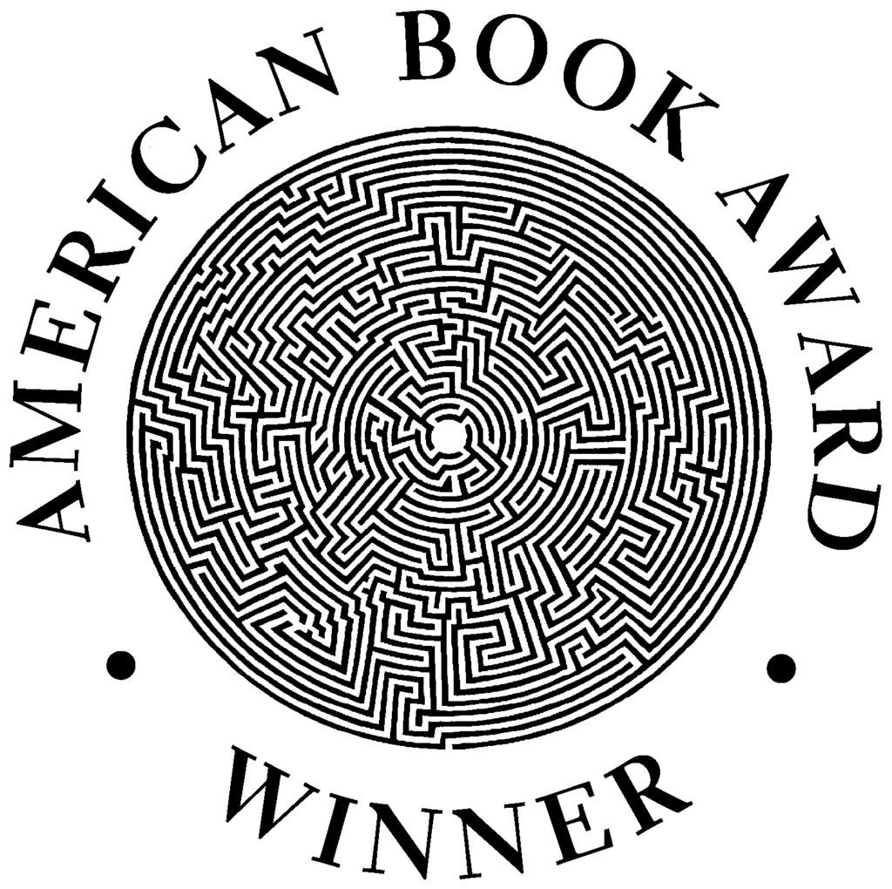
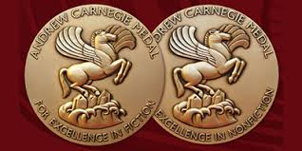
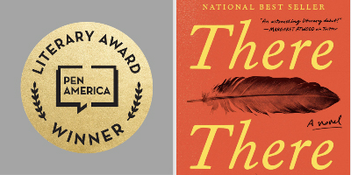
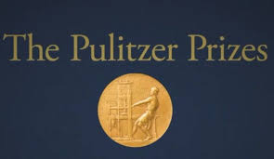
AWARDS & PRIZES
National Book Critics Circle Award’s “John Leonard Prize” 2018
American Book Award 2019
Shortlisted for Andrew Carnegie Medal for Excellence in Fiction
PEN/Hemingway Award 2019
Pulitzer Prize Finalist

Slide 5


IS THERE THERE just hype?
NO!

Slide 6
Works Cited
“2019 American Book Award Winners Announced.” Before \ Columbus Foundation, www.beforecolumbusfoundation.com /foundation-news/2019-american-book-award-winners- announced/.
“The National Book Critics Circle Award.” National Book Critics
Circle, www.bookcritics.org/awards/leonard-prize/.
“PEN/Hemingway Award for Debut Novel.” PEN America, 23 Mar.
2020, pen.org/pen-hemingway-award/.
“There There by Tommy Orange.” Goodreads, Goodreads, 5 June
2018, www.goodreads.com/book/show/36692478-there-there.

